Slide 1
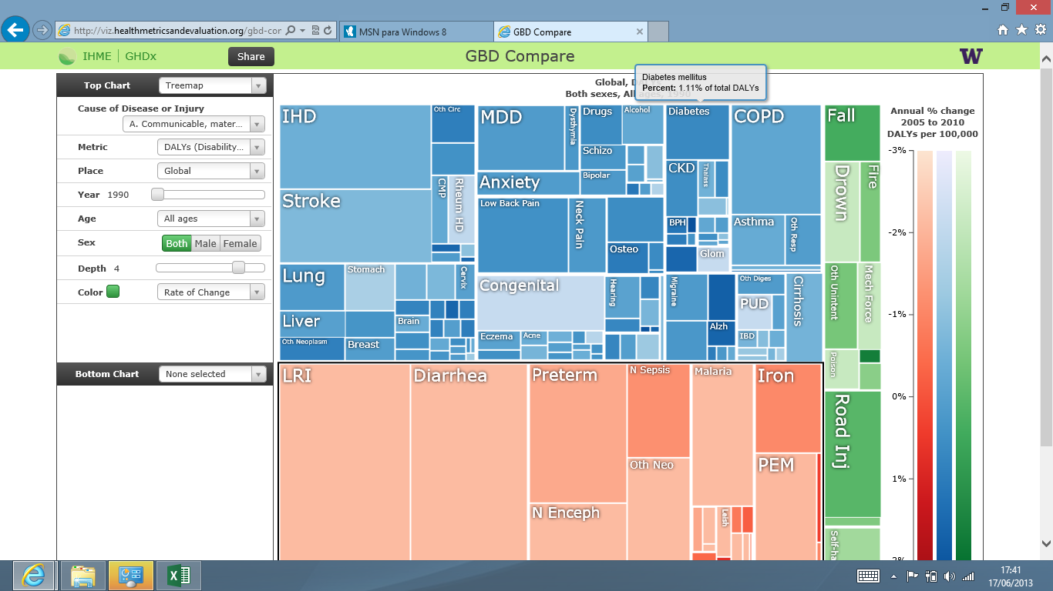
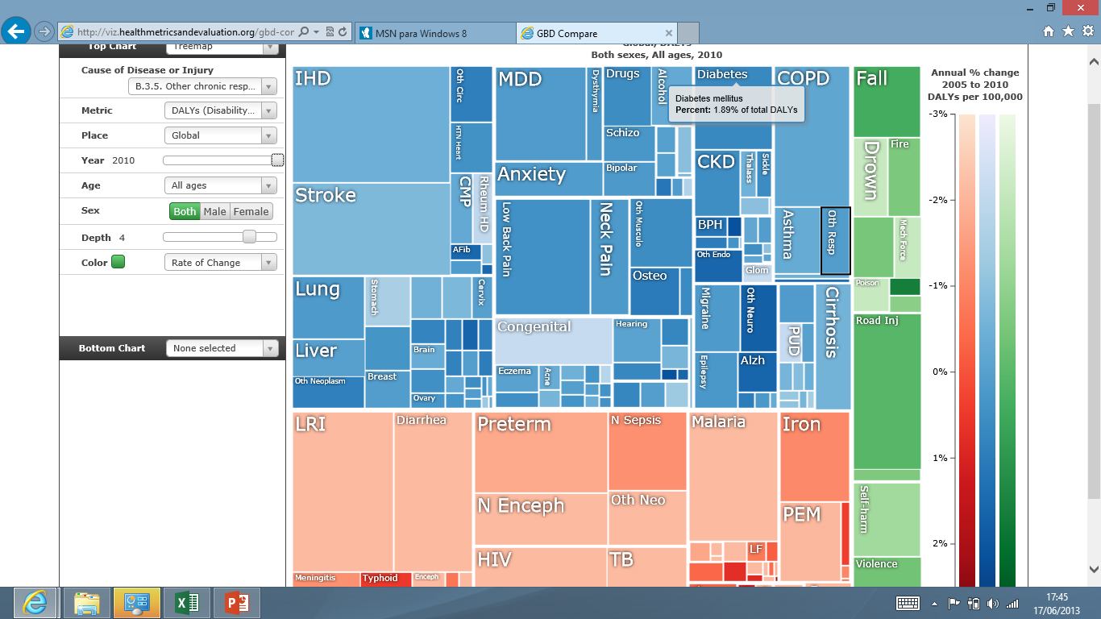

Slide 2
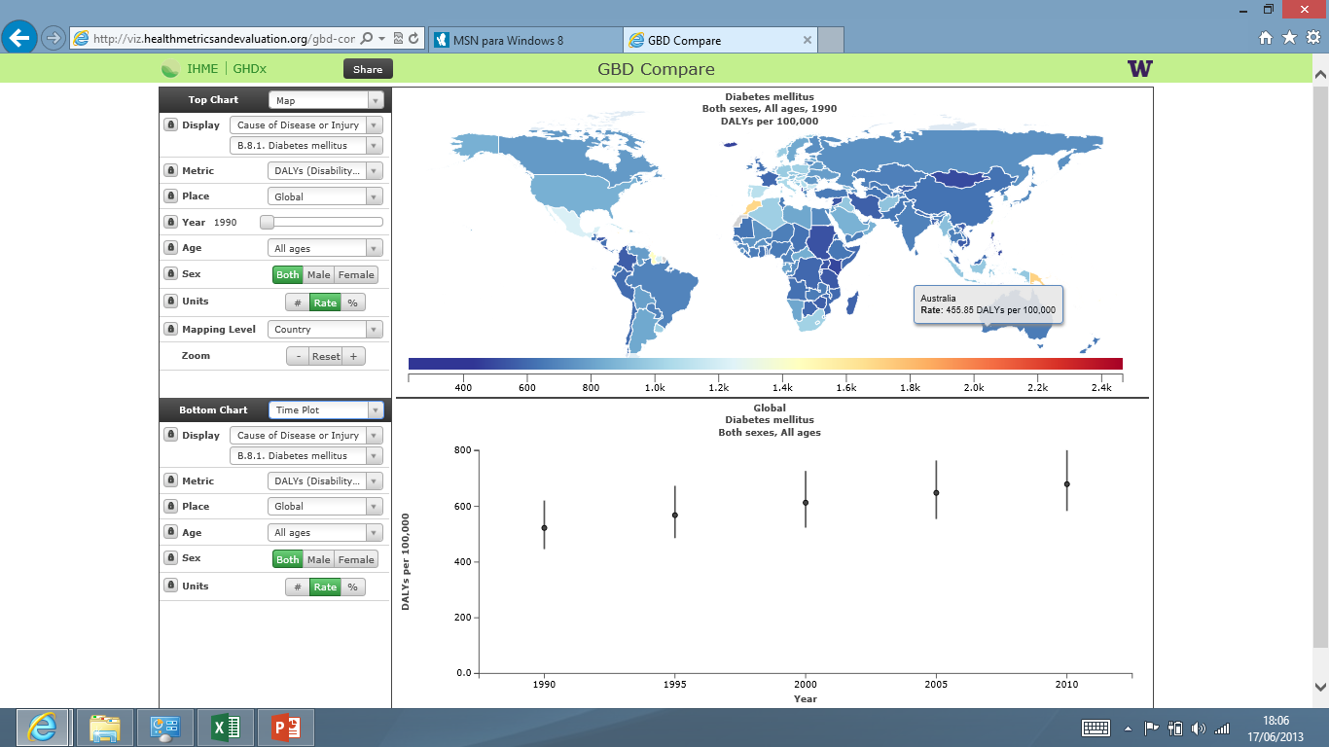
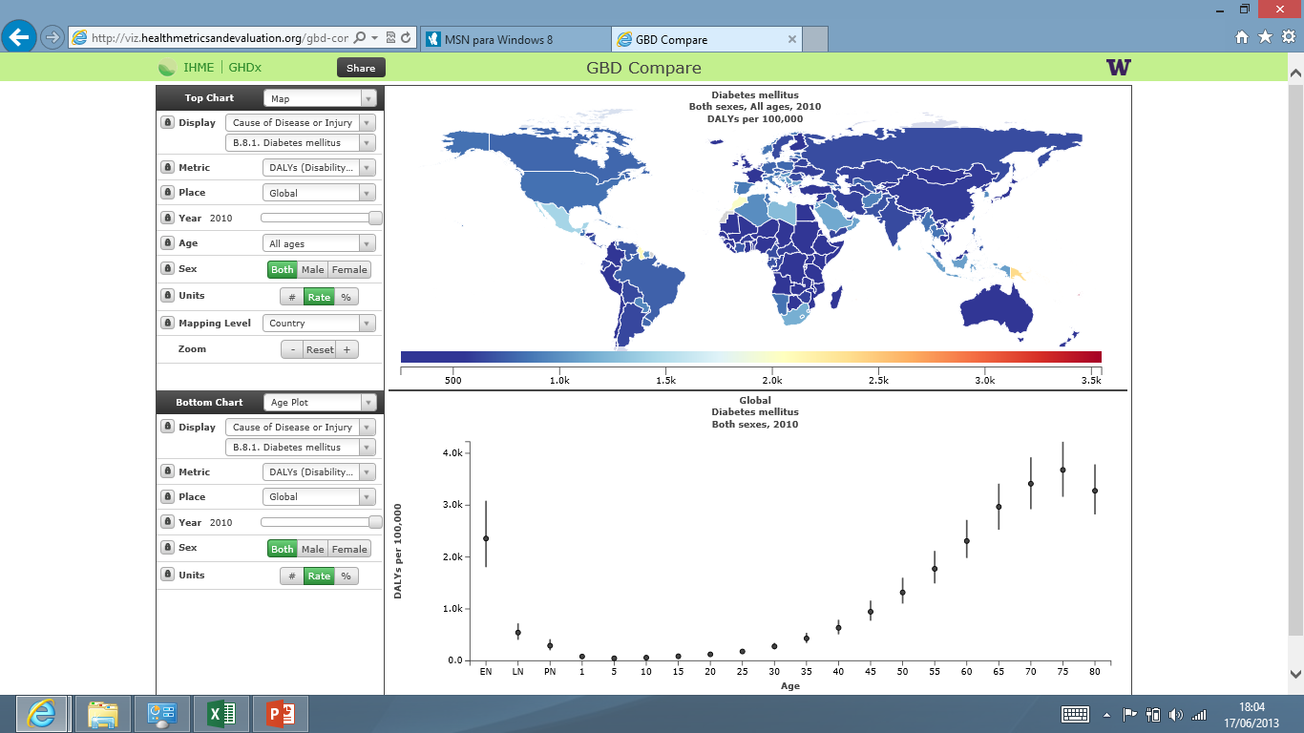

Slide 3
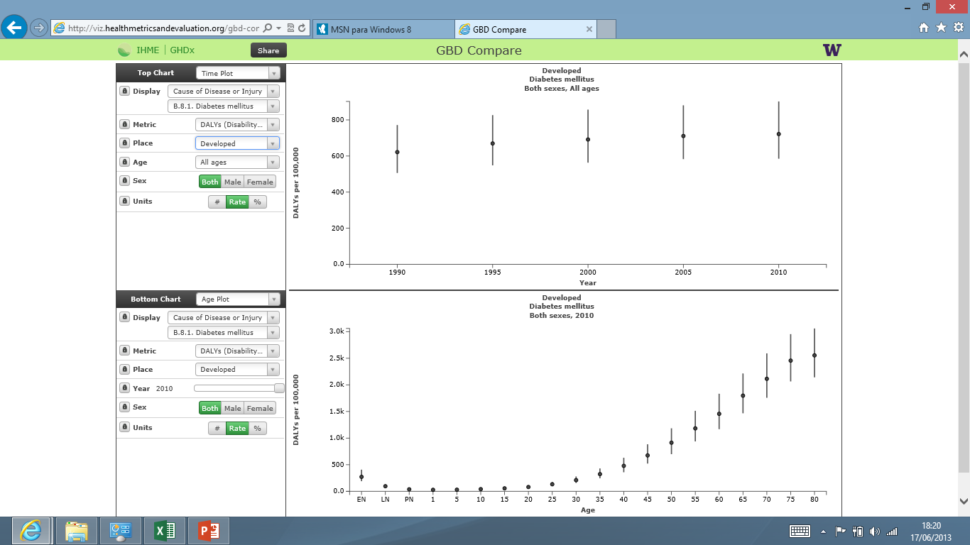


Slide 4
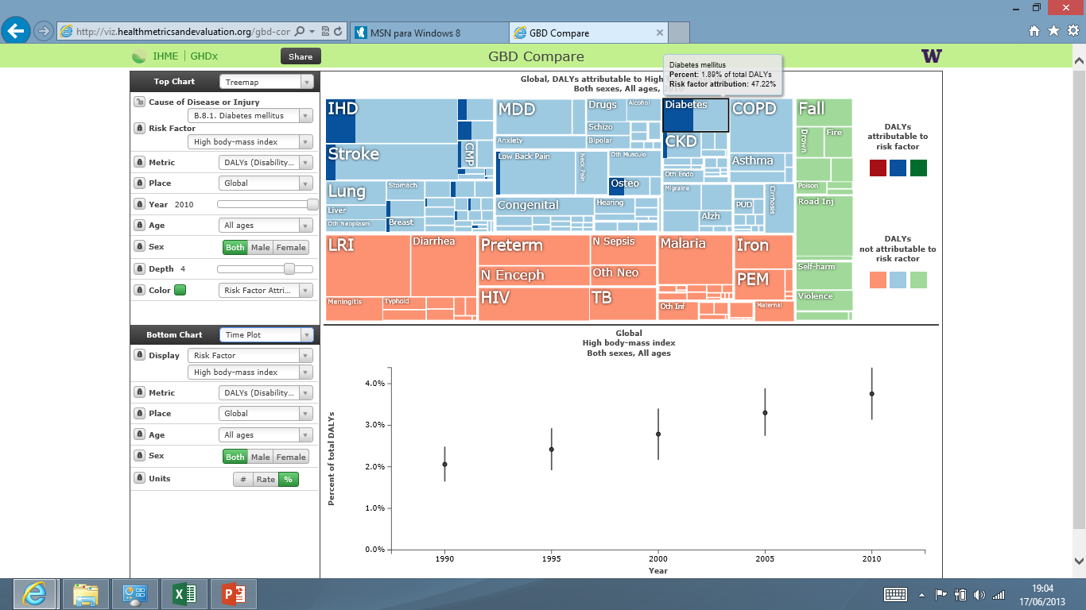
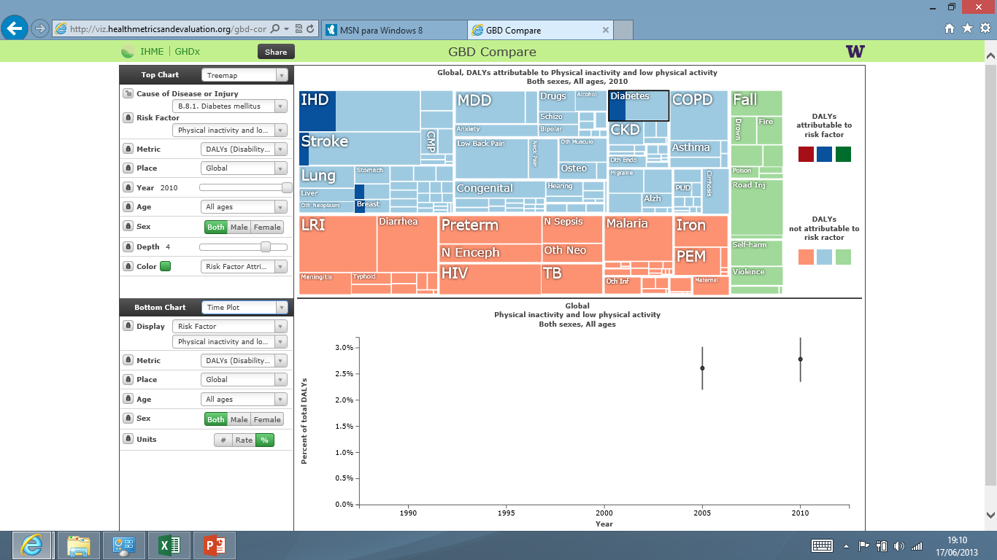
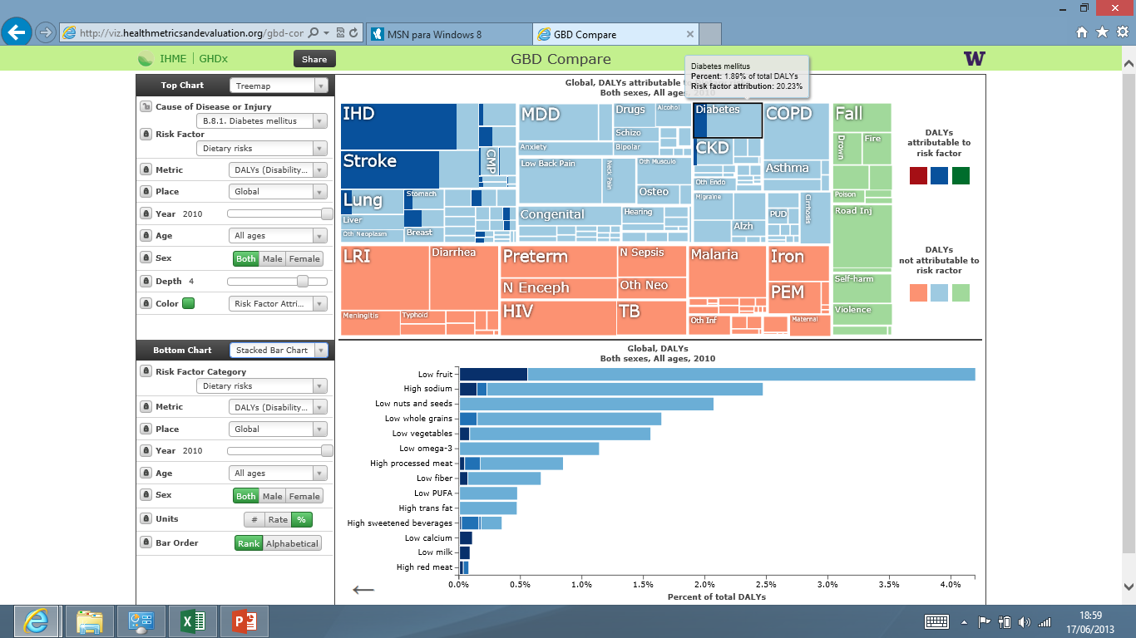

Slide 5
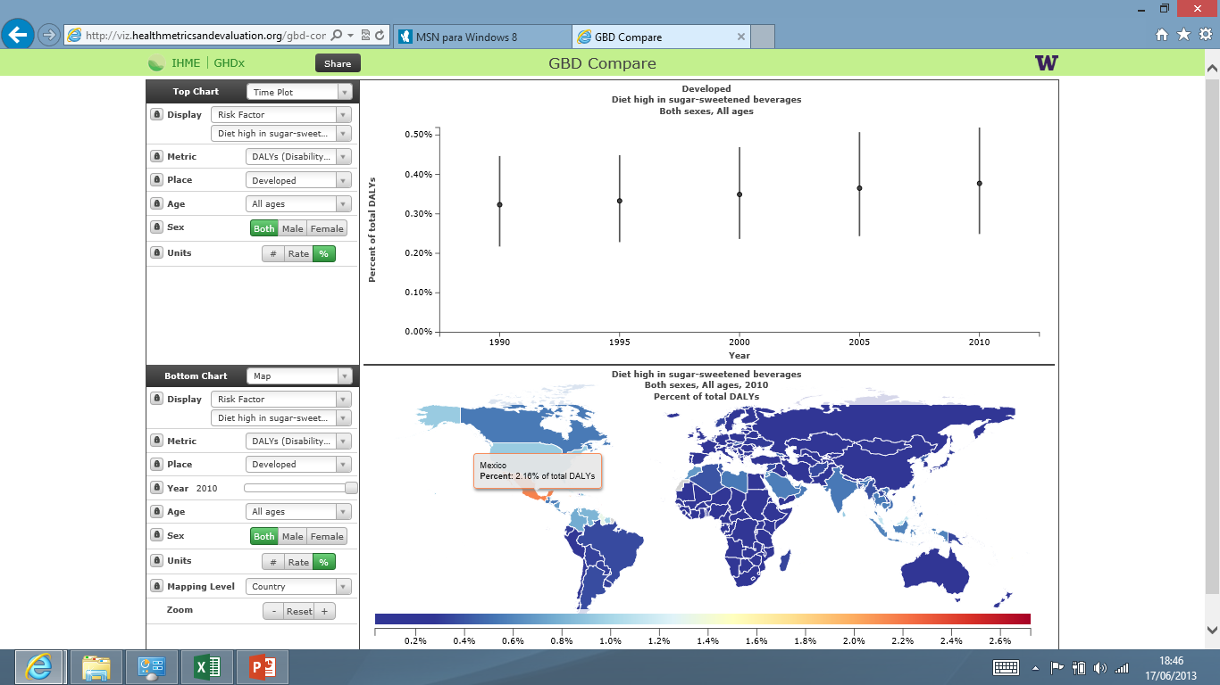

Slide 6
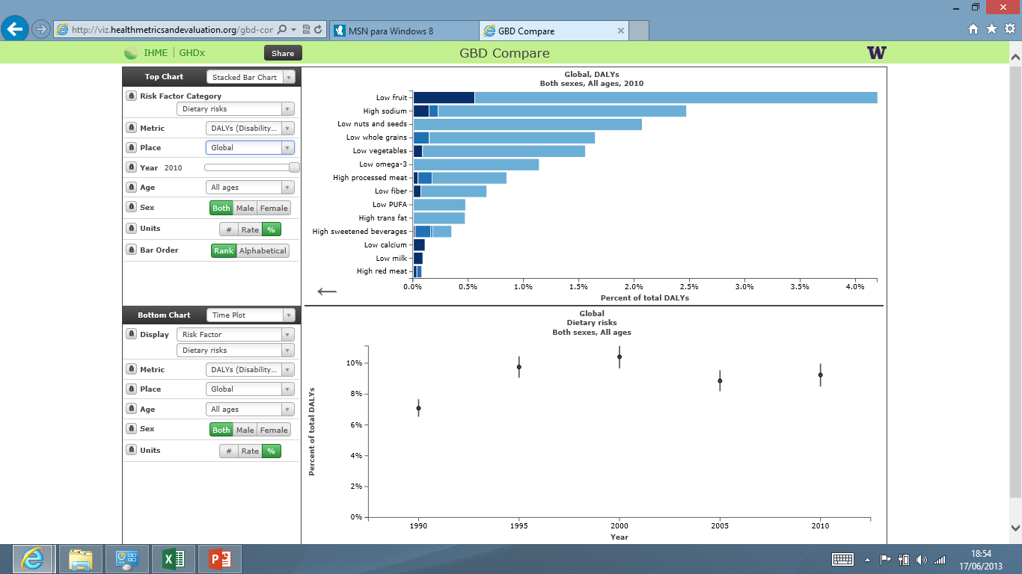
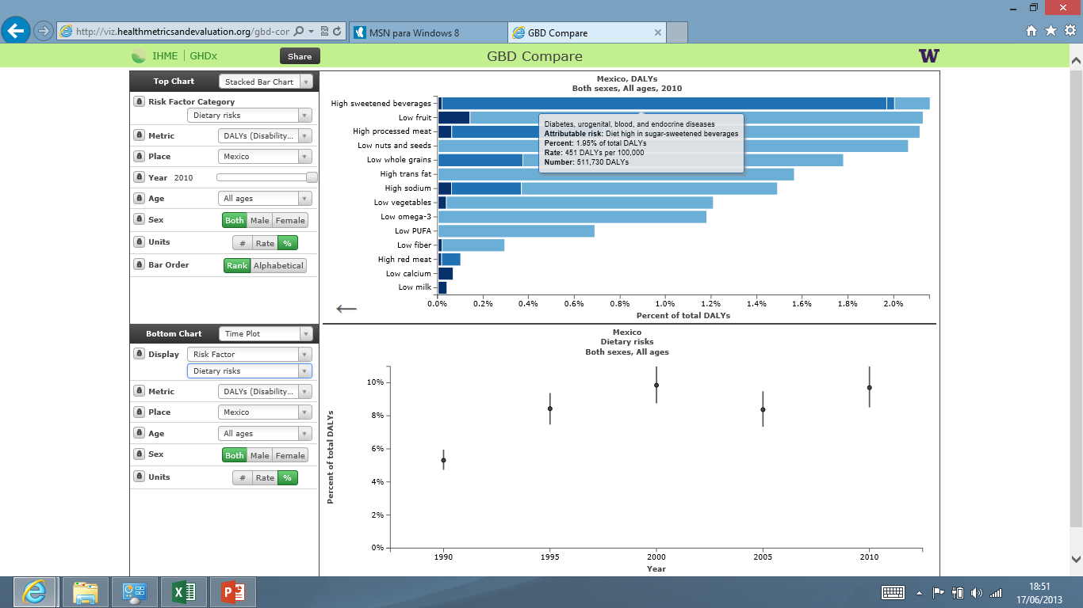

Slide 7
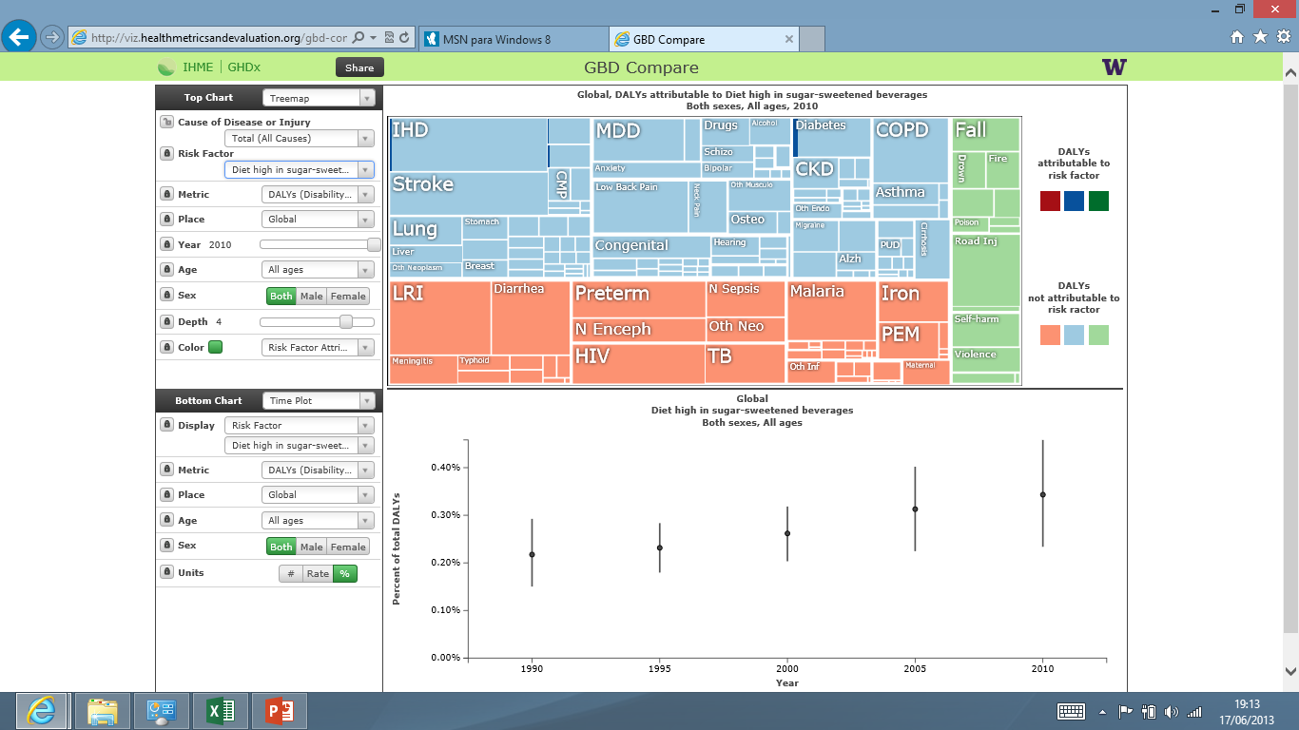
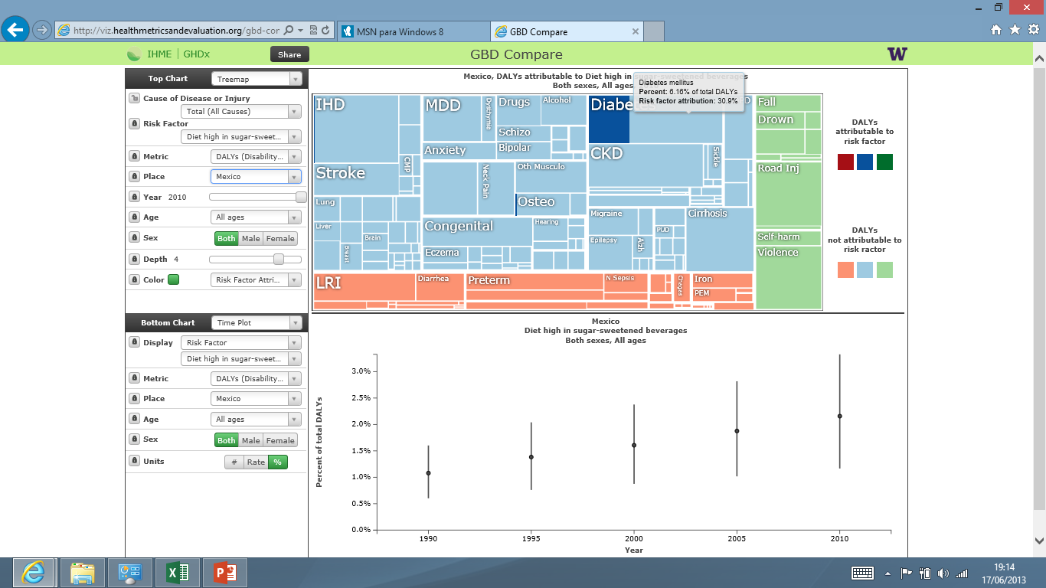

Slide 8
Bebidas azucaradas en Mexico
152 litros por año y persona, 70% cola
7% de los ingresos, un millón de puntos de venta
Aumento en una década del 40%, con igual descenso de ingesta frutas y verduras
Un litro de bebida azucarada contiene unas 13 cucharadas de azucar
Influye en un aumento de sobrepeso del 25% a los 4-10 años, 35% a los 10-25 años y 70% a por encima de los 40 años.
Consecuencia en diabetes, hipertensión y aumento del riesgo de enfermedades cardiovasculatres. La cola tiene efecto en osteoporosis y la cafeina en hiperactividad e insomnio.
Causa la pérdida de unos 580,000 AVAD y 17,000 muertes al año.
Notes:
http://www.oem.com.mx/laprensa/notas/n752335.htm

Slide 9
Potential benefits of regulating the market of sugary drinks in Mexico
15, 000 million liters, some 30 billion dollar sales and some 3 billion dollar benefits per year.
Each 6,000 dollars of benefit relates to one life year lost and each 200,000 dollars relaes to one death attributable to sugary drink intake.
If cost would be inversely correlated with consumption, introducing taxes at a 100% of the price (doubling it) would save 8,000 lives a year, 250,000 healthy life years, increase household resurces by 10%, the productivity and the economy of the country by 0,2% and reduce health care costs by 2%, that is some 1,200 million dollars per year (400 million by halving diabetes raleted costs in the long term).
The taxes collected, some 30 billion, could be used to further reduce the consumption and promote healthier nutrition and lifestyles.

