Slide 1
Criteria of ecologically models as a basis for equitable wellbeing

Slide 2
SUSTAINABLE HEALTH EQUITY MOVEMENT Ethics and metrics webinar series
Criteria of
ecologically sustainable
models (countries)
for
equitable wellbeing

Slide 3
Analysis for discussion
Reminder of previous webinar : CO2 emissions pc ethical threshold
Other natural resources affected by human activity : planetary boundaries
A way to measure human-natural disbalance : the ecological footprint
Interactions between ill planet and human health dynamics
Analysis of countries with carbon emissions, ecological footprint and biocapacity in sustainable and replicable levels.
Regenerative development and the “negative footprint”

Slide 4
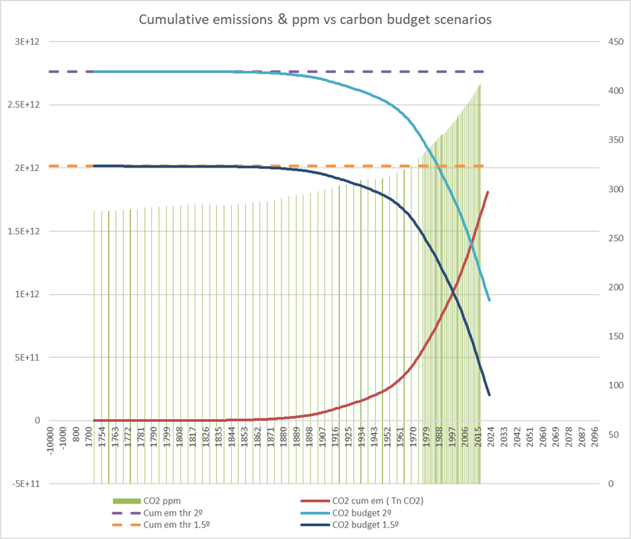
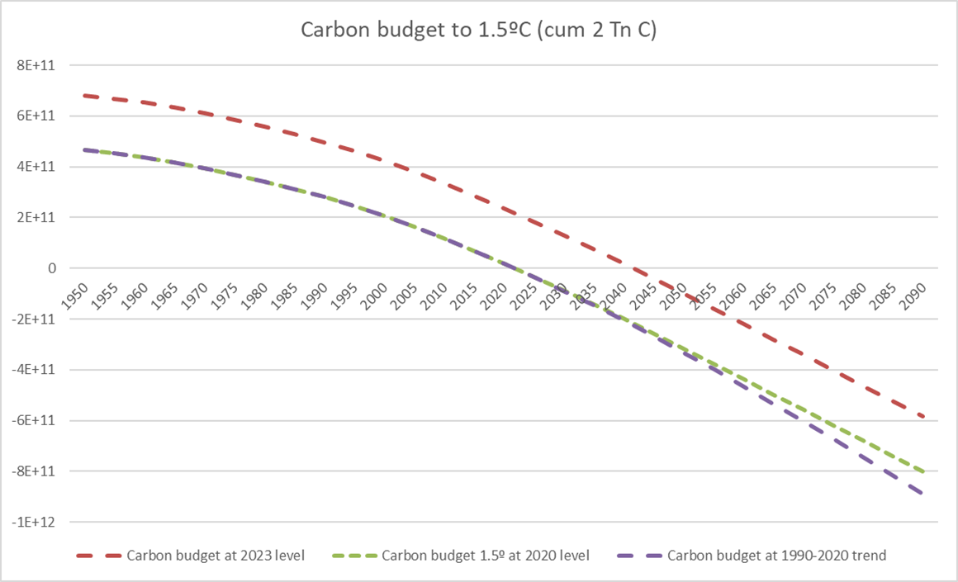
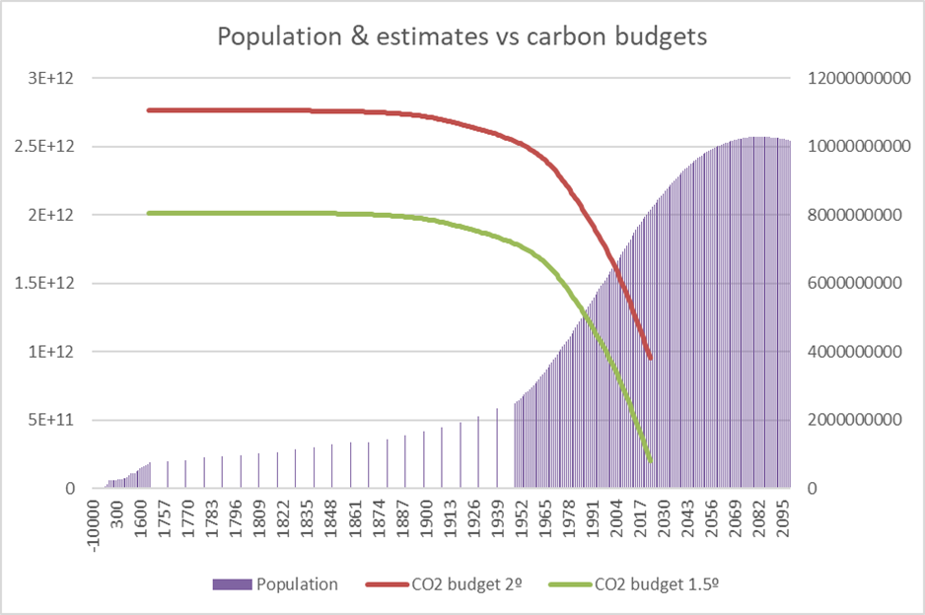
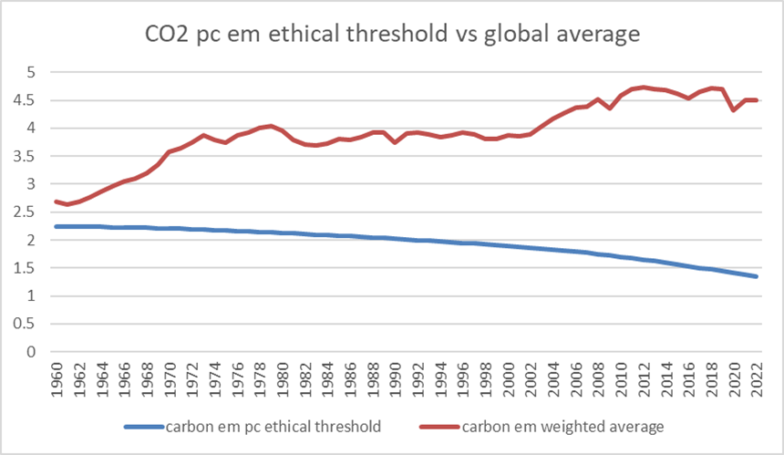

Slide 8
Ecological Footprint
Note that ecological footprints can be counterbalanced by biocapacity, which refers to the ability of a biologically productive area to continuously generate renewable resources and clean up its wastes.
An area is considered unsustainable if a land’s ecological footprint is greater than its biocapacity.

Slide 9
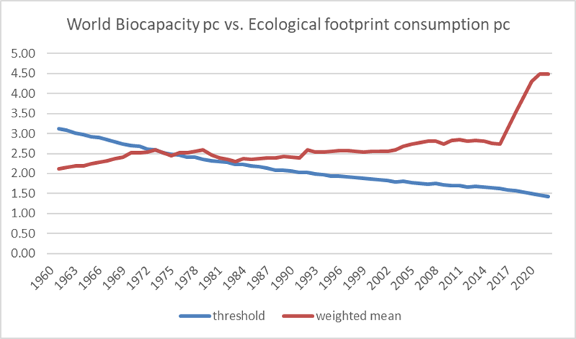

Slide 10
