Slide 1

La ética y la métrica de la
Equidad de la Salud
Juan Garay
ELAM
2 de junio de 2022

Slide 2
1- Premisa ética : Obligación moral de una aspiración colectiva (vidas sanas) que es factible para todos.
Reflejada en la constitución de la Organización Mundial de la Salud de 1947 en la cual todos los 193 estados miembros se comprometen al mejor nivel posible de salud, para todos, el único objetivo compartido por todos los países en salud global.
Dicho objetivo establece un umbrak mínimo y limita, por abajo, la desigualdad injusta (inequidad) –promueve, por lo tanto, la equidad en salud-.
Debería impilicar en “para todos” las próximas generaciones : equidad intergeneracional.
Propuesta : La ELAM puede proponer un cambio al objetivo de la constitución de la OMS : “mejor salud possible para todos los pueblos, incluyendo las próximas generaciones".

Slide 3
2- El mejor nivel posible de salud : nunca ha sido estimado.
(vs. mejor nivel de salud -menor tasa de mortalidad- utilizadopara medir la carga de enfermedad y coste-utilidad, y guiar (con sesgos según países y contextos), las prioridades de salud y su financiación.
Hemos identificado países que desde que hay estadísticas nacionales comparables, desde 1961, cumplen tres criterios : son referencias en vidas saludables pues su esperanza de vida es mayor que la media mundial, son económicamente replicables pues su PIB pc es menor que la media mundial y and ecológicamente sostenibles pues respetan los límites planetarios.
Propuesta : La ELAM podría proponer a las Naciones Unidas la identificación de referencias de bienestar humano que sean economicamente replicables (justas) y ecológicamente sostenibles (en contraste con los modelos del CAD y los del IDH)

Slide 4
3-Compromiso de monitorizar la equidad en salud. No se ha cumplido.
En 2010, tras el trabajo de la Comisión en Determinantes Sociales de la Salud, la AsambleaMundial de la Salud adoptó una resolución en la que todos los países se comprometian a monitorizar la equidad en salud. Hasta el momento sólo algunos países han medido desigualdades en salud en relación a ciertas variables (ingresos, educación, zonas rurales vs. urbanas).
La definición de los mejores posibles niveles de salud permite (a través de ajuste de tasas de mortalidad) la estimación de la carga de inequidad en salud (CiES) -desigualdad injusta- neta : exceso de mortalidad (unas 16 millones de muertes al año) y relativa, (alrededor del 30% de las muertes).
Propuesta : La ELAM podría proponer a la Organización Mundial de la Salud la medición de la carga neta y relativa de inequidad a nivel internacional y subnacional, como major barómetro de justicia social.

Slide 5
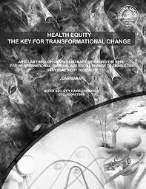


Indicatores utilizados en la selección de países SRS : saludables, económicamente replicables y ecológicamente sostenibles
Estudios | Criterios de salud | Criterios económicos | Criterios ecológicos
1960-2010 Albania, Armenia, Belice, Colombia, Costa Rica, Cuba, Granada, Saint Lucia, Saint Vincent, Georgia, Paraguay, Sri Lanka, Tonga y Vietnam | Esperanza de vida > media mundial | PIB (VC) pc < media mundial | Emisiones de carbono < nivel responsable de 2° de calentamiento global (1990-2010)
1960-2015 Armenia, Colombia, Costa Rica, Paraguay, Sri- Lanka y Tonga | Esperanza de vida en hombres > media mundial Esperanza de vida en mujeres > media mundial Esperanza de vida en todos > media mundial | PIB (VC) pc < media mundial PIB (PAC) pc < media mundial PNB (VC) pc < media mundial PNB (PAC) pc < media mundial | Emisiones de carbono < nivel responsable de 1.5° de calentamiento global
1960-2020 Sri-Lanka Y regiones sub-nacionales en China (Shanxi, Guangxi, Anhui, Sichuan and Henan), en India (Kerala), en Rusia (Ingushetia and Chechnya) y en Brasil (Alagoas, Praiba, Ceara, Para, Bahia y Rio Grande) | Esperanza de vida en hombres > media mundial Esperanza de vida en mujeres > media mundial Esperanza de vida en todos > media mundial Esperanza de vida saludable > media mundial | PIB (VC) pc < media mundial PIB (PAC) pc < media mundial PNB (VC) pc < media mundial PNB (PAC) pc < media mundial Riqueza por persona (2020) < media mundial | Emisiones de carbono < nivel responsable de 1.5° de calentamiento global Bio capacidad pc < media mundial Huella ecológica pc < Bio capacidad media mundial

Slide 6
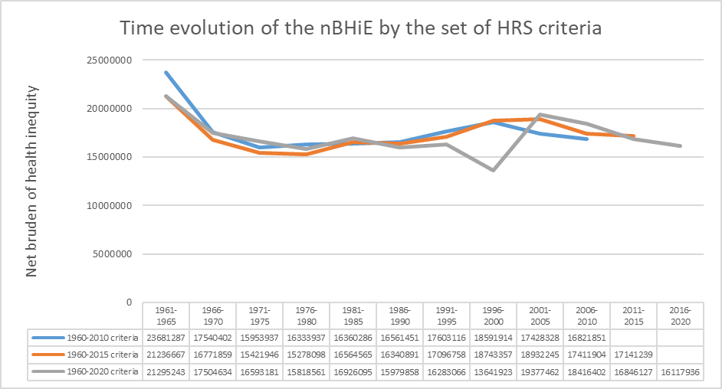

Slide 7
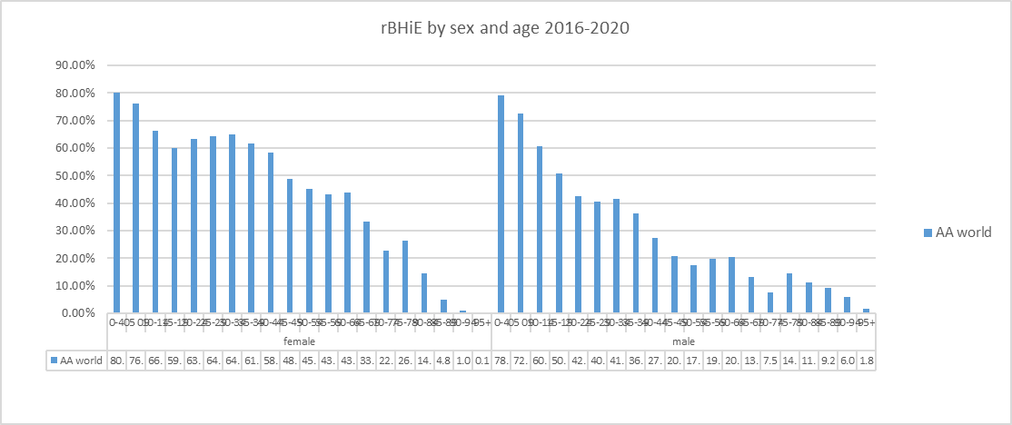

Slide 8
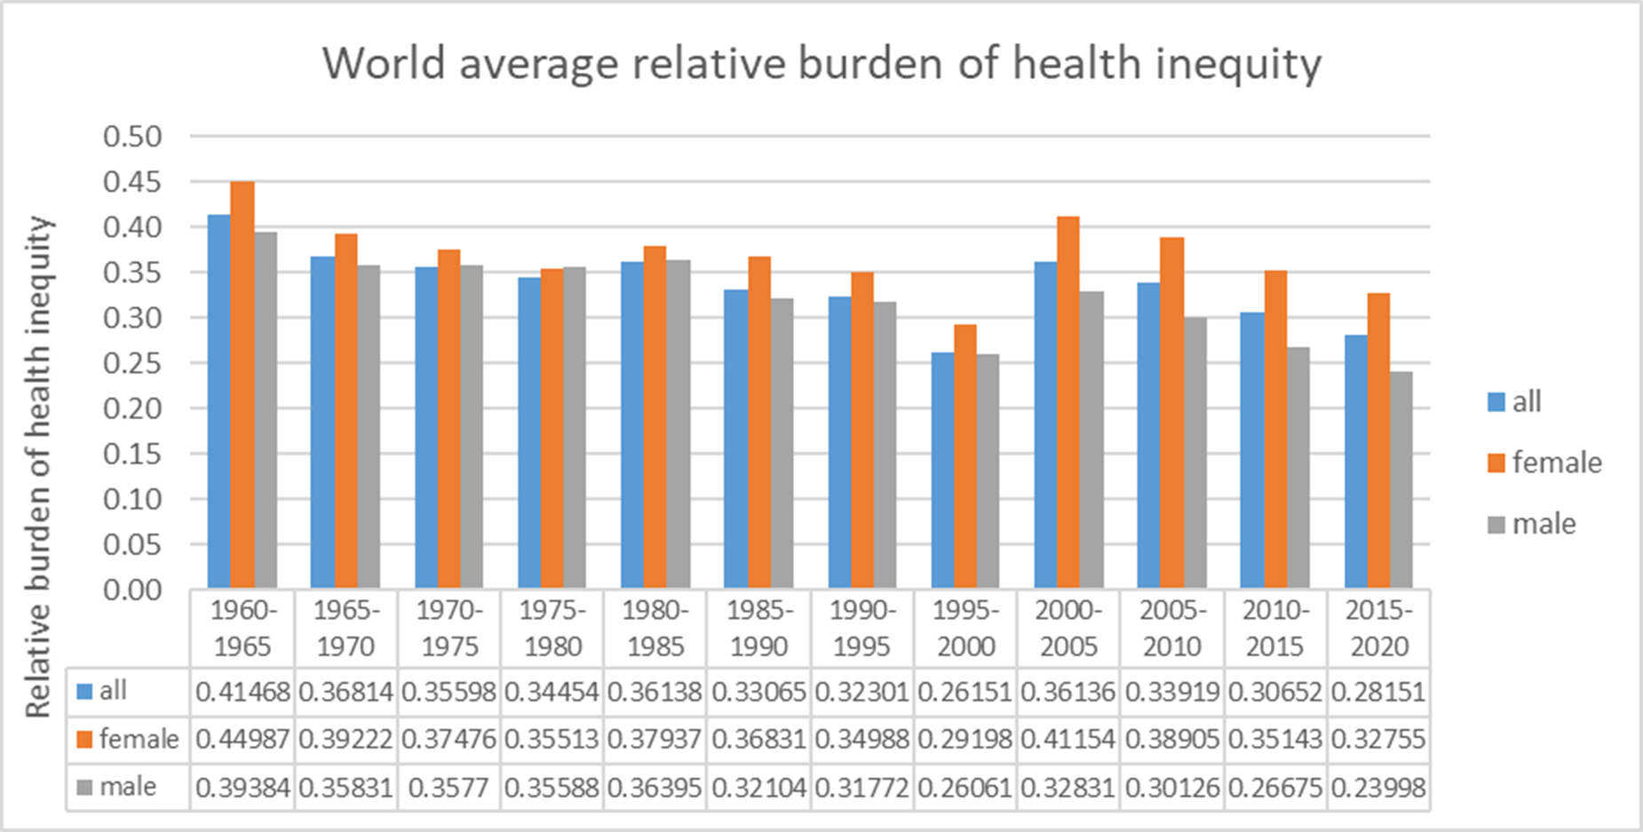

Slide 9

Base de datos interactiva
Close to two million data , mostly from algorithms based on international (UN, WB, WHO, others) reports analyzing HRS criteria, burden of health inequity (nBHiE and rBHiE) SHE index and ethical redistribution.
By 250 countries and regions, time period of 5 years from 1960-2020, sex and 5 year age grouops (0-100 years old).

Slide 10
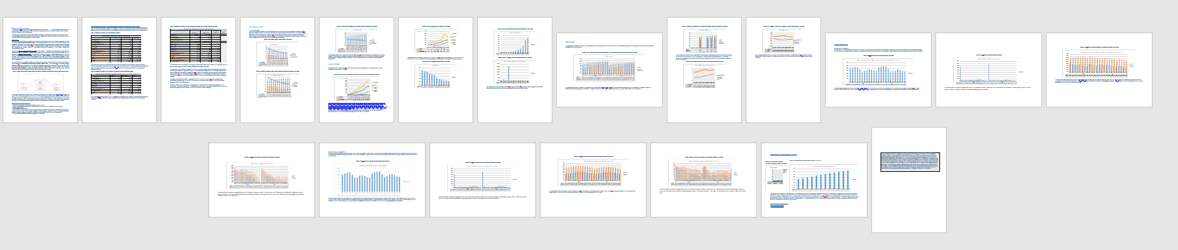
SHE atlas
170 countries >100,000 pop : 20 pager “country SHE profile” with 21 graphs, 3 comparative tables, one summary
Over 50 dynamic (time) maps of SHE related variables and indicators

Slide 11
4- Dignity threshold vs. poverty
The average GDP pc of references of feasible/sustainable wellbeing sets the minimum income (dignity threshold) that enables the right to health (feasible for all).
The dignity threshold stands today at some 10$ pcd, some 5 times higher than the extreme poverty threshold set by the world bank. Some 2/3 of the world population lives with income levels insufficient to enjoy the best feasible/sustainable level of health for all.
Proposal : SHEM could advocate to amend the World Bank's definition and setting of poverty threshold and propose the dignity threshold enabling the foundational right to health (allied with the UN commission on human rights).

Slide 12
5- Excess threshold vs.unlimited income/wealth
Above the GDPpc of the best feasible level of health for all people (dignity threshold), life expectancy/health/wellbeing can improve until a level of income above which LE does not improve any further. It so happens that above that level all countries trespass planetary boundaries. Such level (excess threshold) is very similar to the symmetrical point from the dignity threshold and above the world average.
The income equity curve between the dignity and excess threshold enables a minimum level of LE/wellbeing feasible for all and the maximum LE/wellbeing levels to inspire progress, within a scope of fair inequality (equity).
The ratio of Dgth:ExTh is around 1:7, the GINI varies from asymmetric 0.15 (3 times lower than international average) to 0.015 (normal symmetric distribution) and the level of redistribution required is of some 10% of GDP (vs. ODA 0.3%), some 20% of unnecessary GDP above excess threshold levels.
Proposal : SHEM could advocate a model beyond failed models of free market capitalism and government controlled socialism that advocates for economic equity between and within countries through economic transparency and fiscal and territorial redistribution at global (UN, SDG 10, global wealth tax-Picketty and Stiglitz) and subnational levels (tax equity initiative).

Slide 13
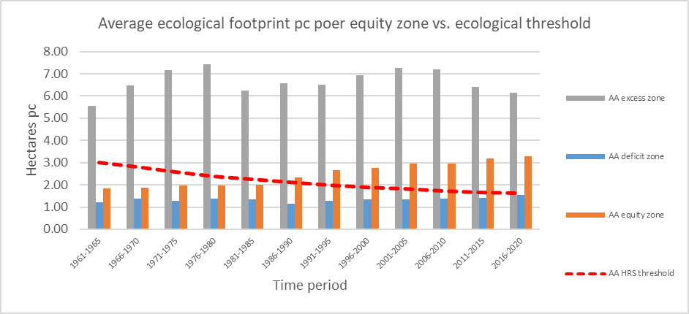
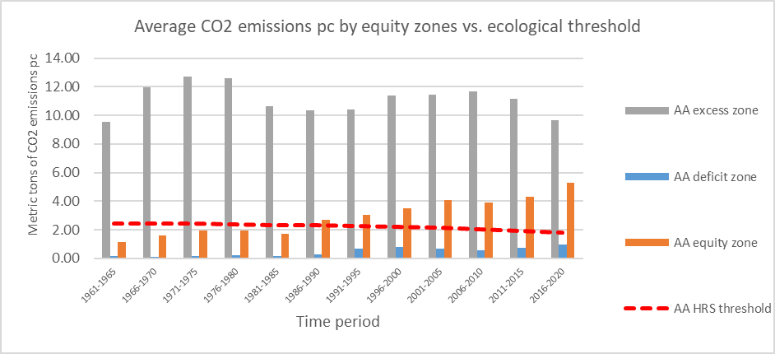
Ecological sustainability by Equity zones

Slide 14
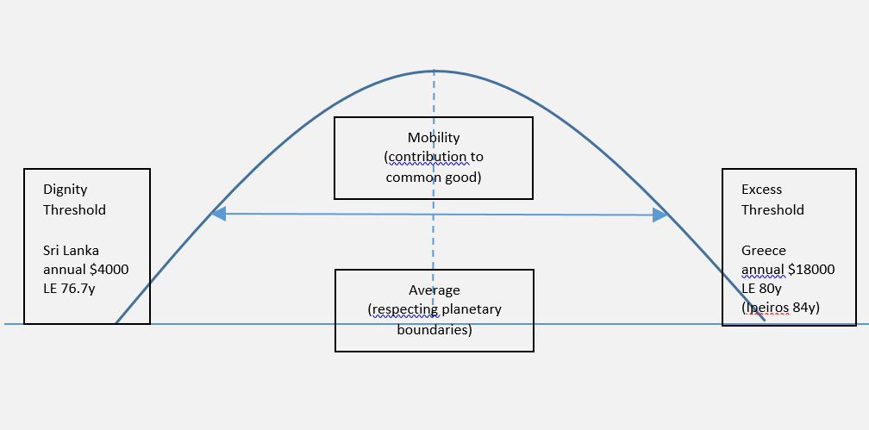
The Equity curve
Deficit
Equity
Excess
Healthy
Non healthy

Slide 15
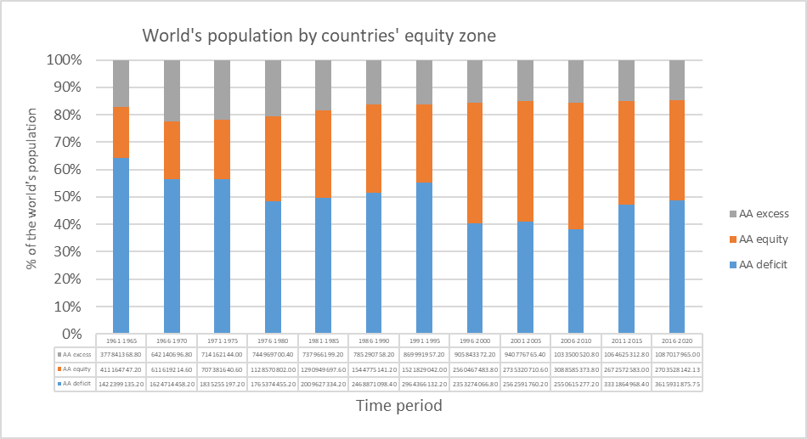
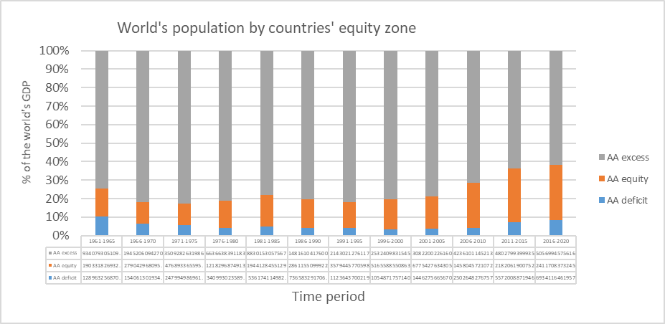
Countries´population and GDP by Equity zones
GDP
Population

Slide 16
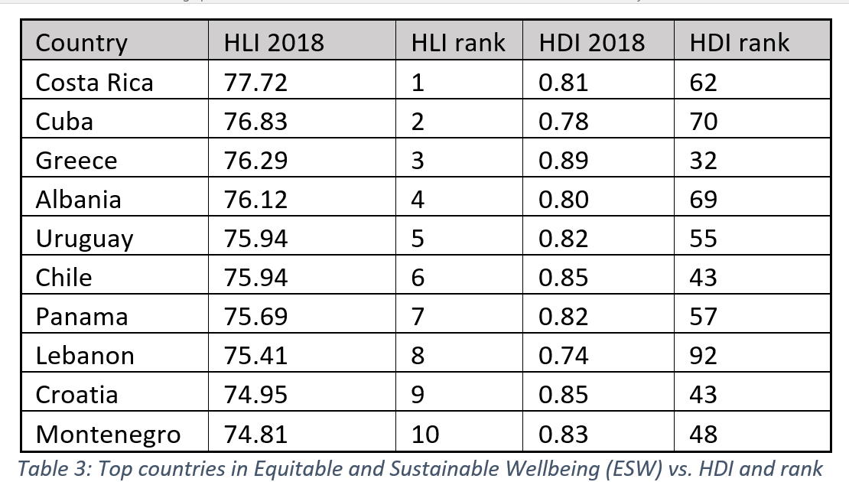
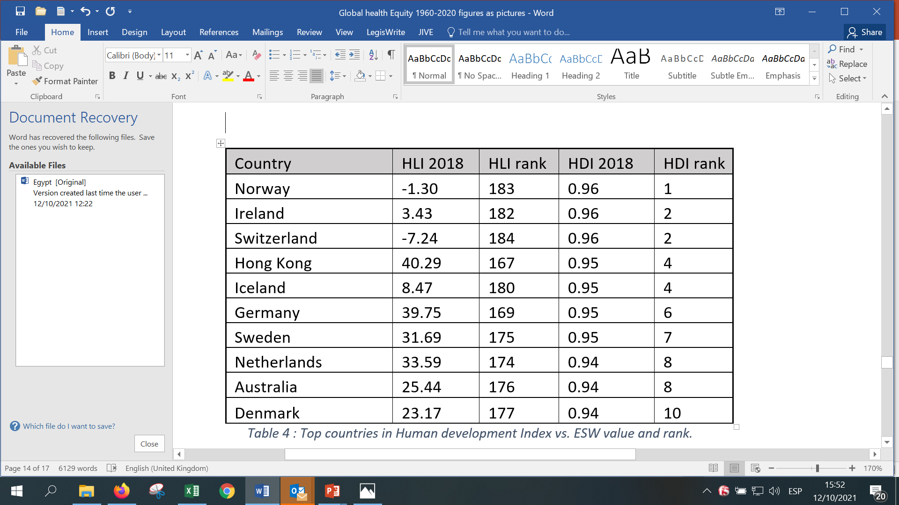
Sustainable and Equitable Wellbeing
A : one week life lost per annual GDP pc 1000$ above the excess threshold
B: two life days lost per annual excess CO2 ton above the ethical threshold
SHE index : LE x (1-((A/52)-(B/365)))
(very different from HDI)

Slide 17
6-Intergenerational Equity vs planetary boundaires
Inter-generational equity/justice is threatened by the trespassing of planetary boundaries. The most urgent one, carbon emissions will (if trend restored after Covid continues) cause, only by temperature increase, some 220 million excess mortality this century. (third world with no guns).
The carbon footprint threshold above which 1,5° increase/point of no return will be met and mean the worst ever intergenerational legacy in humankind history is today around 1mTn pcy : ethical threshold : >90% of the world population ignores this threshold and his/her own footprint. (app : footprint for life)
Ecological footprint and global bio-capacity pc also set the thresholds on use of natural resources.
There is a powerful synergy between the respect of the planetary boundaries and the economic equity curve. Income (leading to consumption -demand driven production- or savings -mainly fuelling global markets-) correlates with carbon emissions and ecological footprint. Local ecological production/consumption and income below excess threshold enable the respect of planetary boundaries. (estrategia de municipios sostenibles-Cuba)
Proposal : SHEM could advocate through social media and UN for the ethical conscience, respect and regulations to reduce CO2 émissions < 1mT pcy.

Slide 18
Ecological sustainability by Equity zones

Slide 19
7.-Global Public Goods
The equitable redistribution of resources and limit to the excess income and accumulation in progressively fewer hands, enables the freeing of global resources which should primarily be channelled for international collaboration towards knowledge, development and universal and equitable (by needs) access to Global Public Goods.
The AIDS pandemic took 10 years to turn knowledge into access to ARVs (with some 20 million deaths related to the greed of some patent monopolies) and the recent COVID pandemic revealed again a world driven by market dynamics rather then the ethics of health equity.
Proposal : SHEM could advocate to the UN the discussion towards a framework convention on Global Public Goods where increased public research funding feeds a global agenda of priority human challenges and ensures the link between global advancement of knowledge and equitable access through Global Public Goods.

Slide 20
Real life meeting of SHEM?
Cuba, at a crossroads, offers in the Cuba-salud Congress in October 2022 the space for SHEM to physically meet and call for global action on the ethical principle of health and economic sustainable equity.

