Slide 1
Equity in the 2030 agenda The global challenge with a focus in the LAC region
Juan Garay
HoC, DEU Cuba

Slide 2
2030 SDGs-2015 MDGs-1945 UDHRs-360 BC…
The form of law which I should propose would be as follows:
In a state desirous of being saved from the greatest of all plagues
-here should exist among the citizens neither extreme poverty,
nor, again, excess of wealth,
for both are productive of both these evils.
Now the legislator should determine
what is to be the limit of poverty or wealth.
Laws by Plato, 360 BC.

Slide 3
equity
Equity = Fair distribution of inequality
Fair =
Fair Access/rights - Shared aspirartion achievable by all (and coming generations)
Fair Contribution/responsabiities - …with collective contribution (according to means)
Fair Distribution=
Fair Access according to needs + Fair Contribution according to capacities
(eg. Fair Health (LE) = Equitable health services based on fiscal equity)

Slide 4
Equality vs equity
 | Inequality vs equality | Inequity vs Equity
Concept | Differences | Unfair differences
Measurement | Differences or ratios between sub-populations. | Gap from best feasible and sustainable level: burden of inequity.
Objective | Arbitrary reductions vs utopian equality | Eliminate inequities
Strategy | Approach to most disadvantaged groups : poverty alleviation (diff. with feasible wellbeing/LE/right to health for all) | Identification of minimum and maximum thresholds: social cohesion (address both extremes), levels of dignity and universal rights.
Effect | Mitigation | Transformation

Slide 5
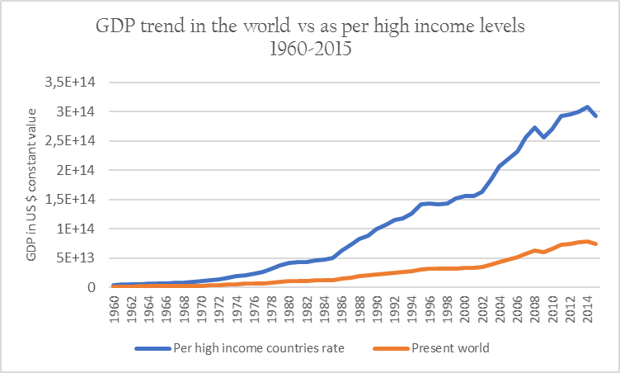
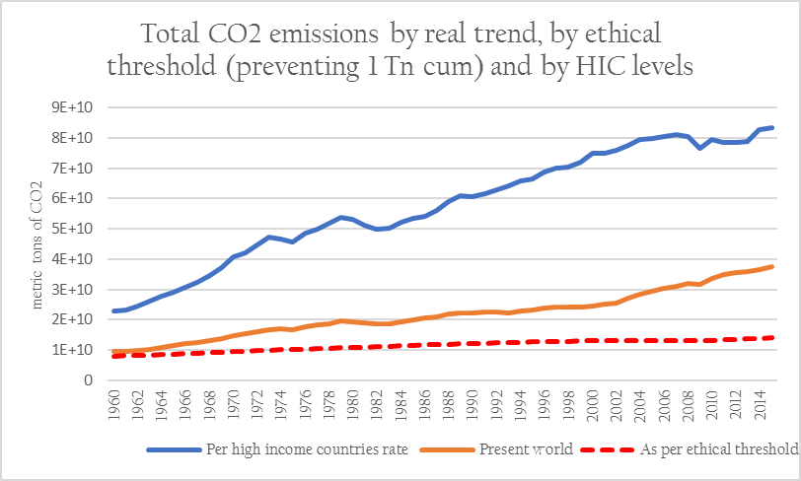
High income countries`(DAC) model : non-replicable and non-sustainable

Slide 6
Well-being achievable by all?
Most quantitative and qualitative wellbeing indicators are correlated with better health and higher life expectancy.
Best feasible health for all (WHO constitution 1947/art 25 UDHRs)
Levels of life expectancy above average feasible/achievable by all :
Related to resources /variables accesible to all :
GDP pc < average
Use of resources sustainable for coming generations :
< thresholds of planetary boundaries

Slide 7
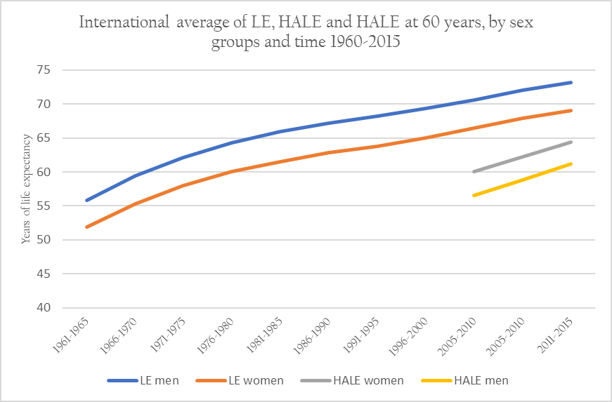
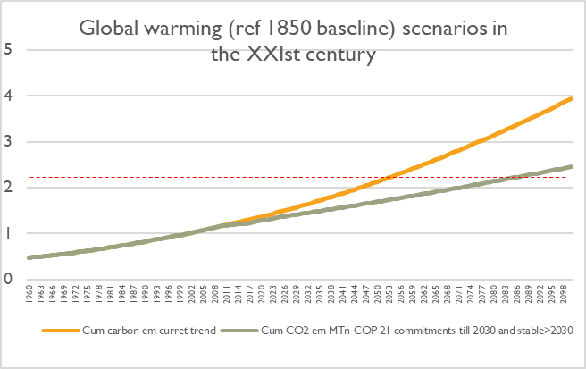
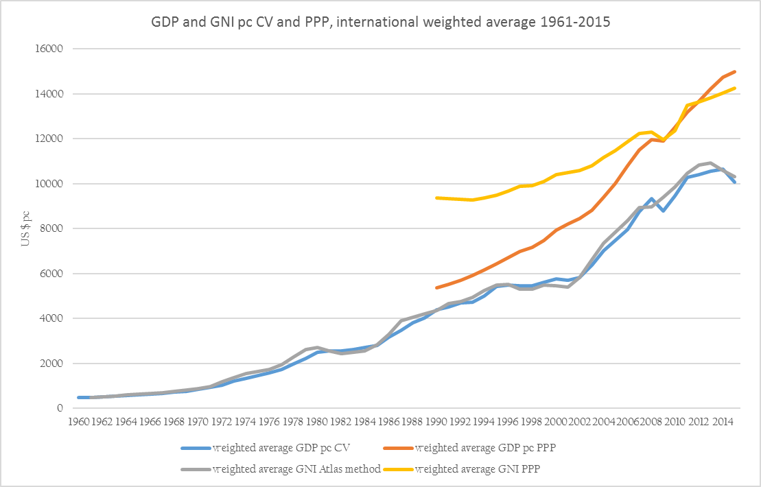
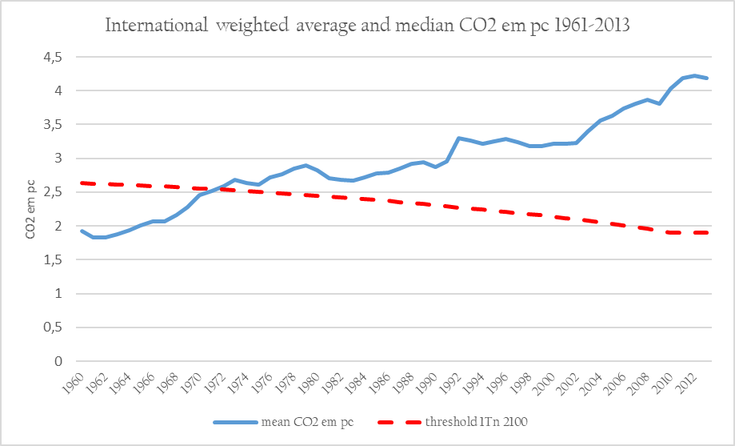
HRS criteria

Slide 8
HRS criteria and countries in time

Slide 9
Constant HRS countries

Slide 10
HRS regions in largest countries (2000-2010)

Slide 11
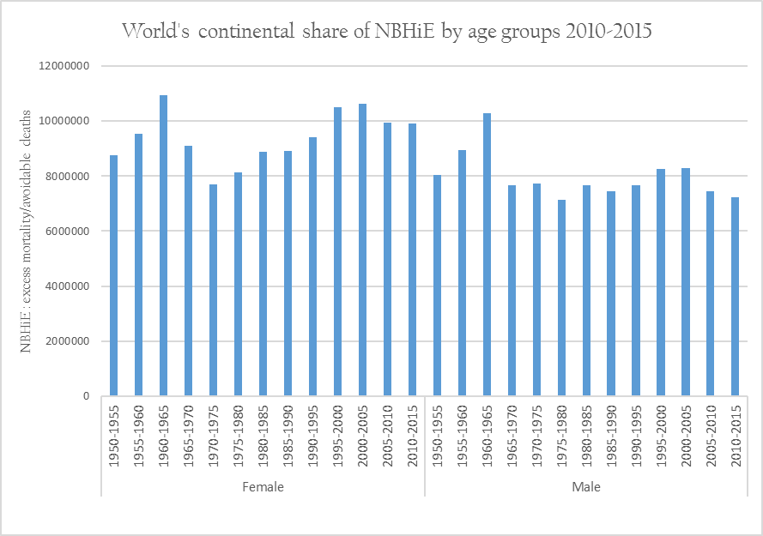
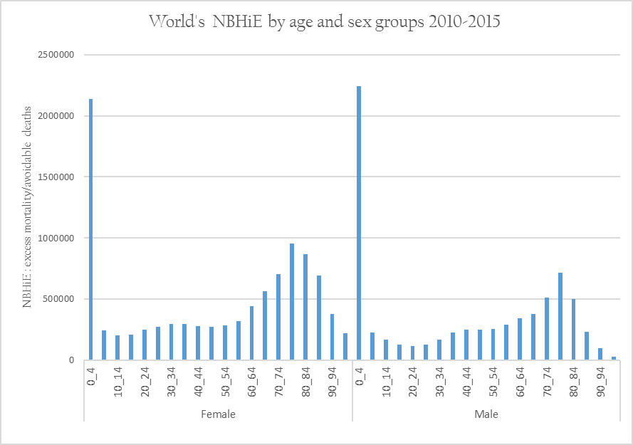
NET Burden of health inequity-NBHiE (ref constant hrs models)

Slide 12
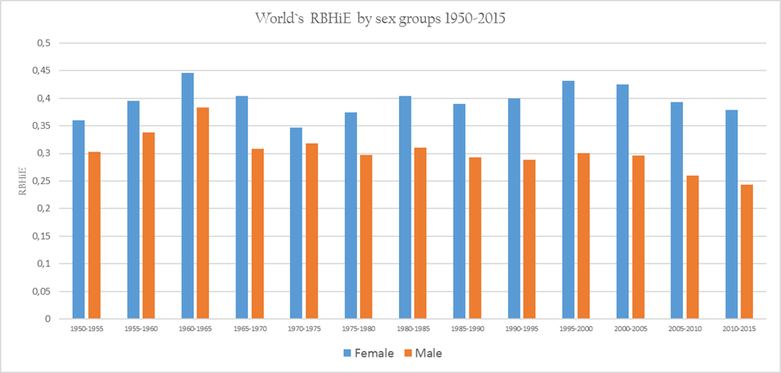
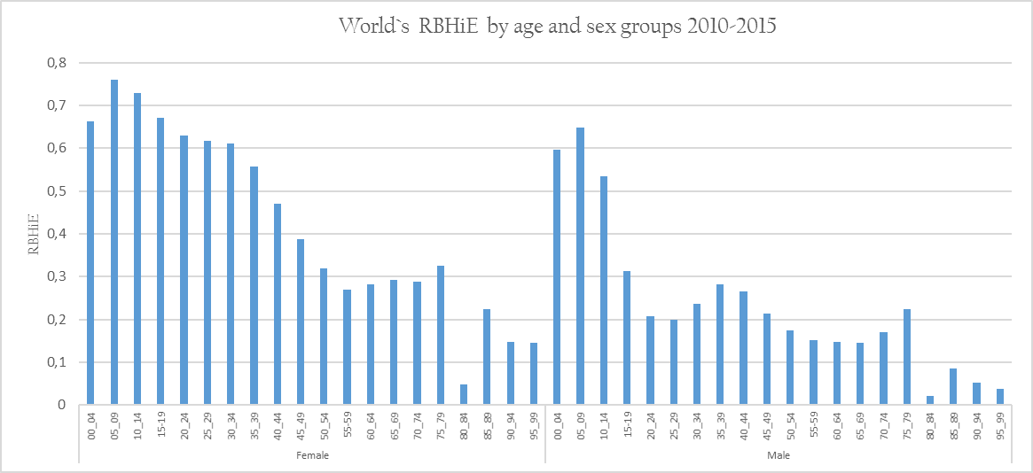
% Burden of health inequity-RBHiE (ref constant hrs models)

Slide 13
RBHiE trend in time and by countries –global

Slide 14
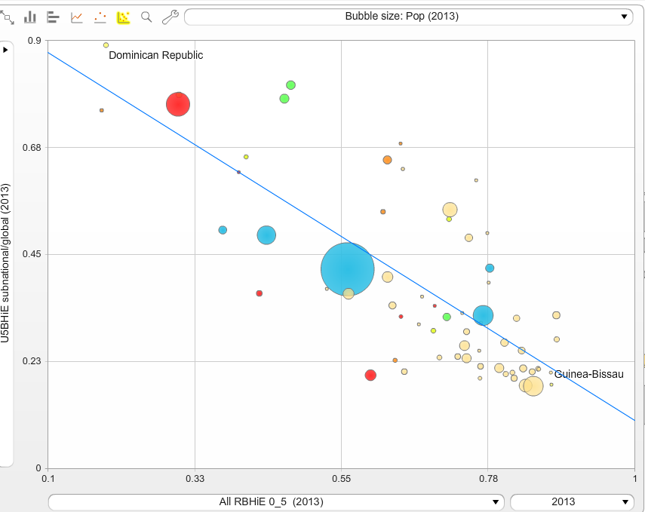
Subnational RBHiE estimates (Health equity monitor U5MR by Q)

Slide 15
Sub-national HR(S) models and RBHiE

Slide 16
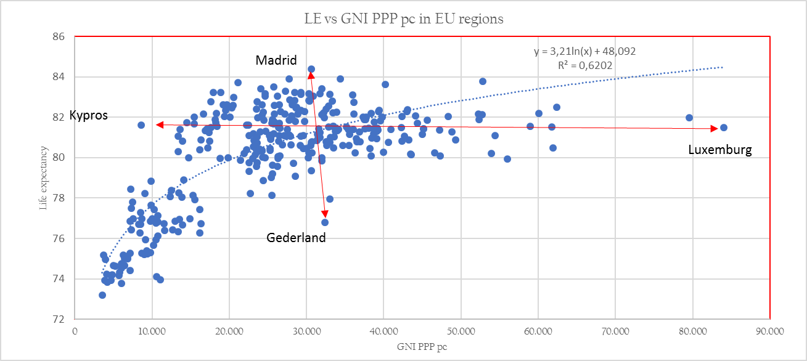
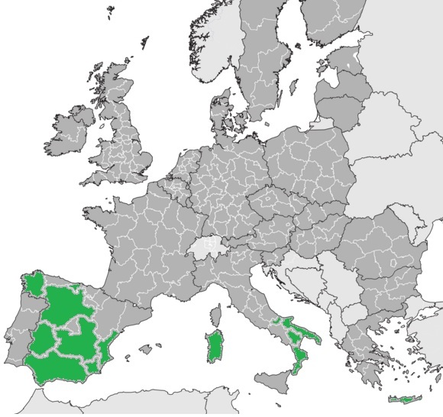
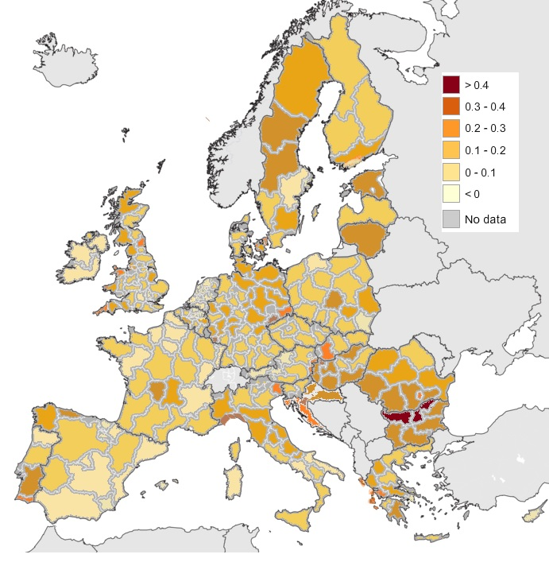
EU sub-national (NUTS2) HR(S) & RBHiE

Slide 17
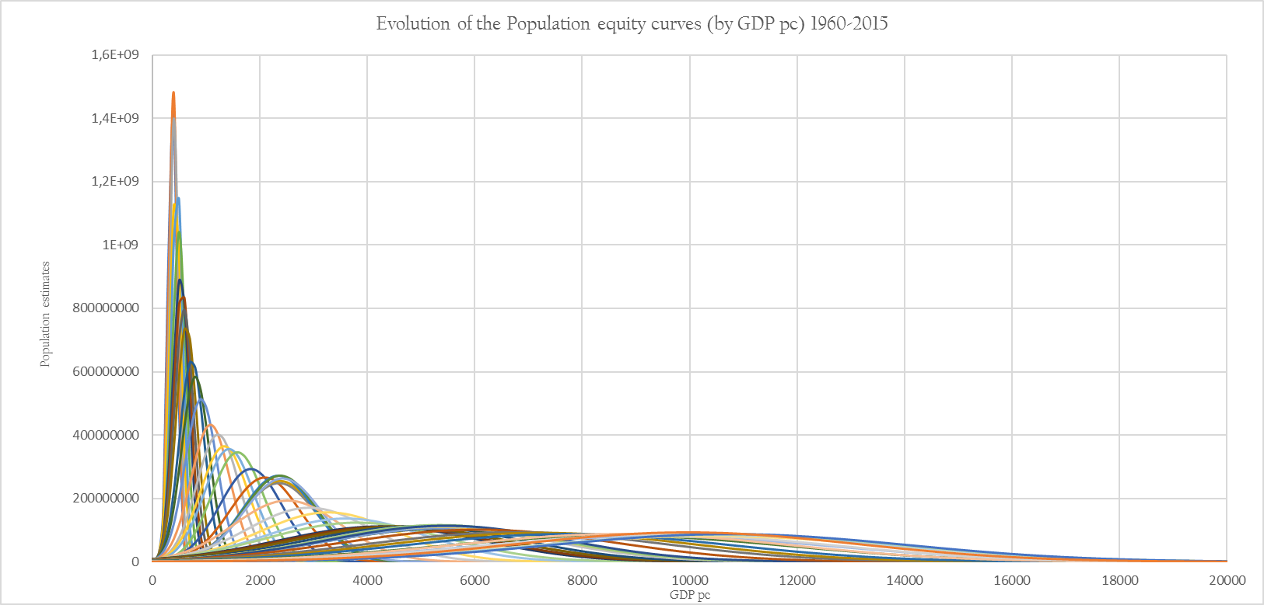
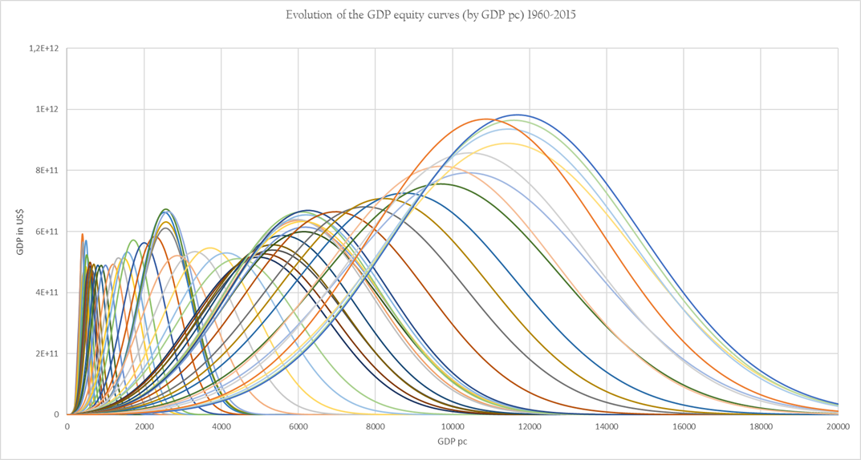
Economic equity distribution

Slide 18
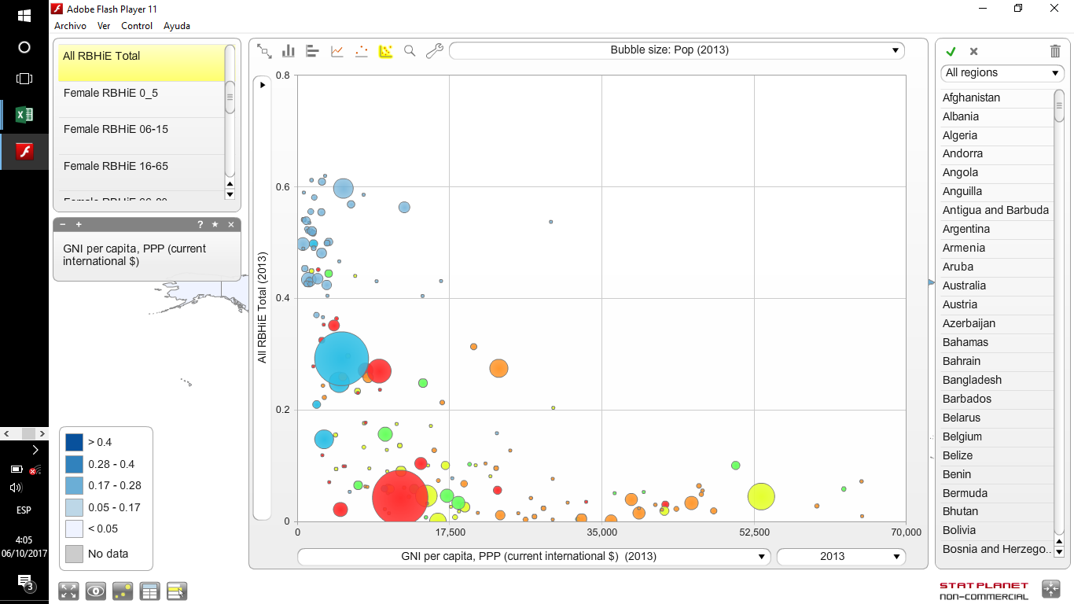
Correlation GDP pc with RBHiE Global and LAC
DTh
UTh

Slide 19
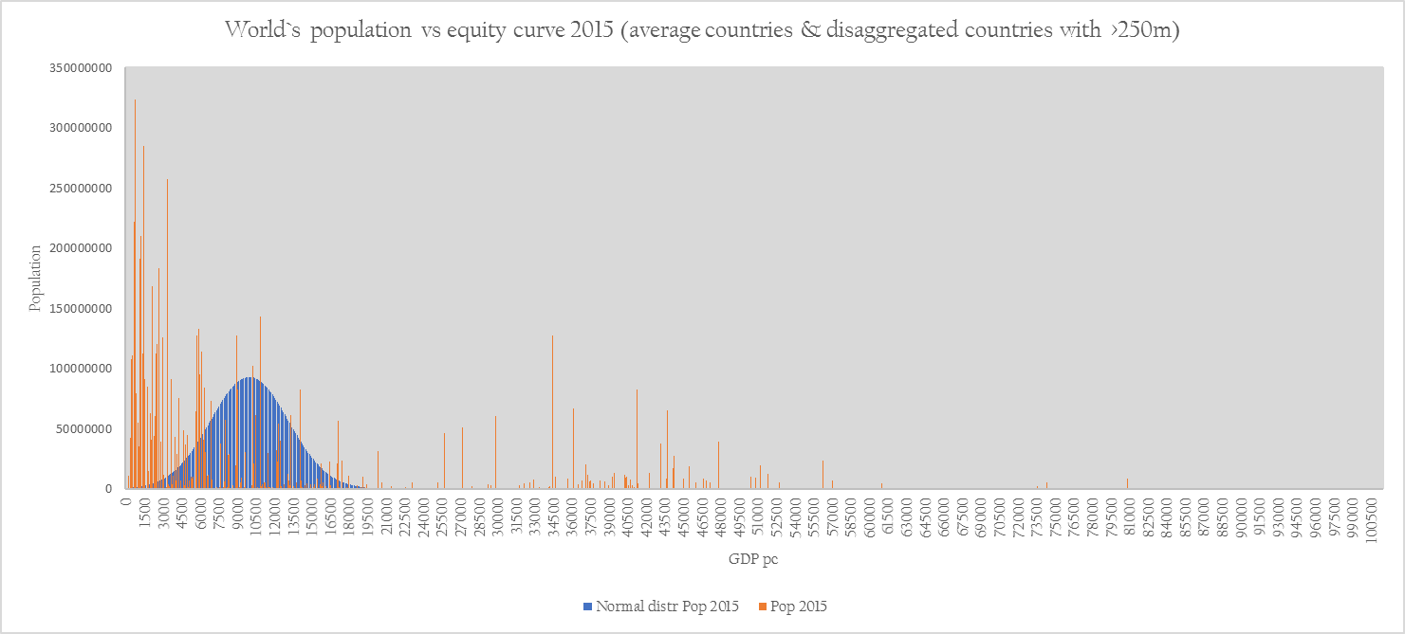
Equity of national average GDP pc vs present world`s pop distr

Slide 20
Equity of national average GDP pc vs present world`s GDP distr

Slide 21
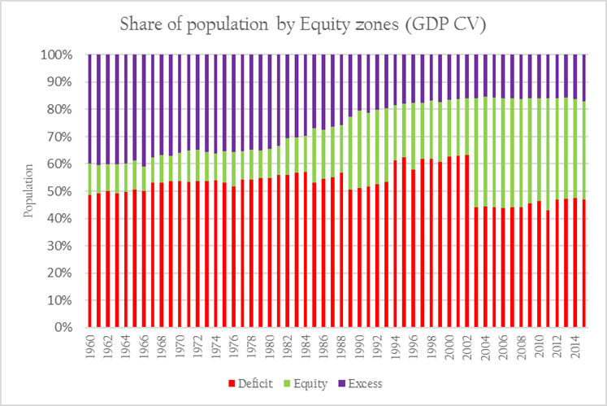
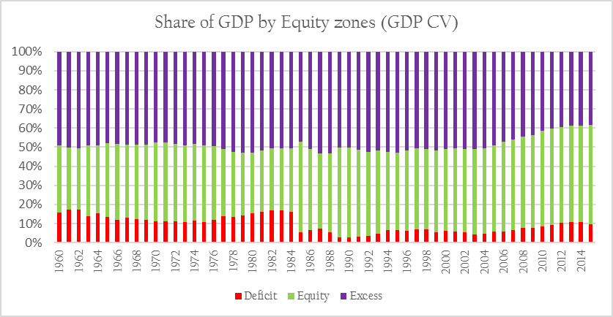
Equity zones –trend in time

Slide 22
World`s distribution of equity zones in time

Slide 23
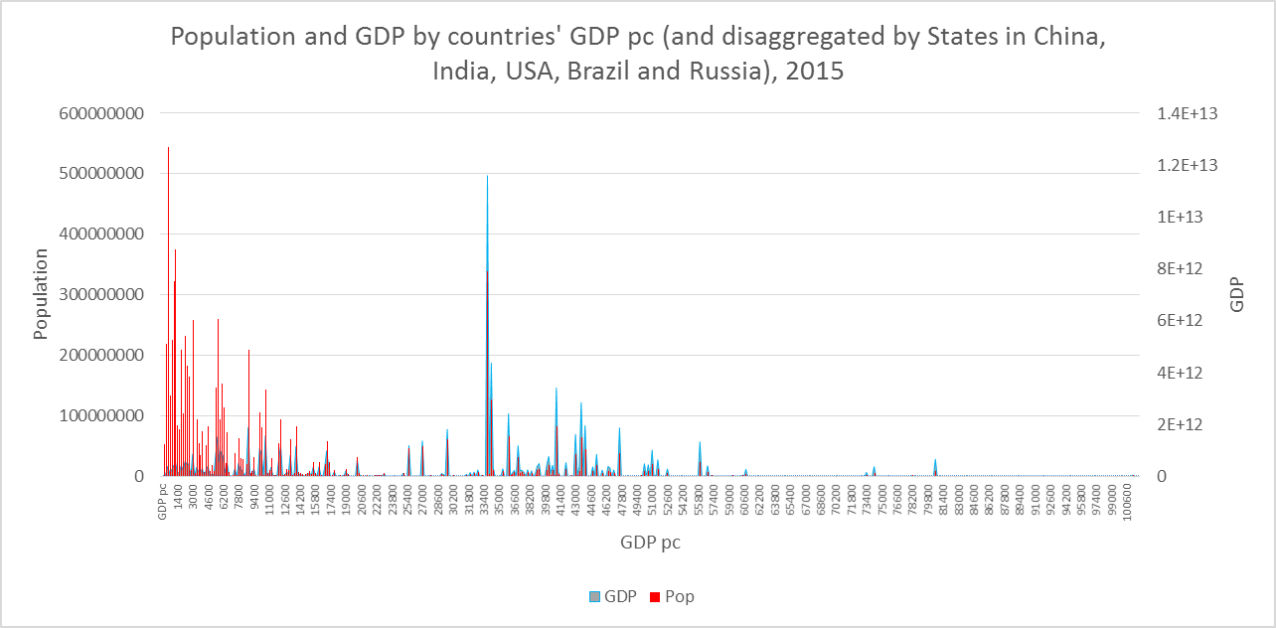
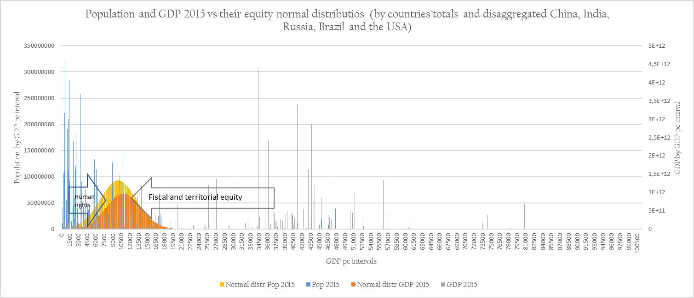
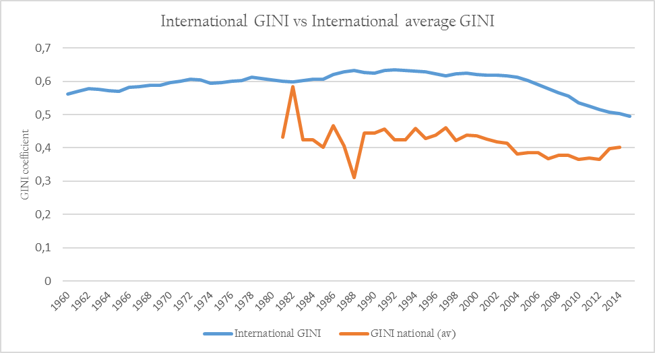
Economic inequity vs inequality

Slide 24
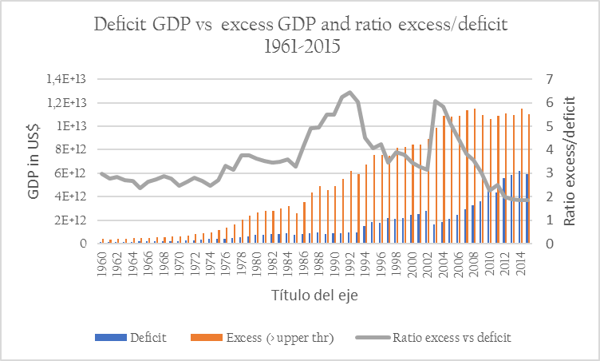
International redistribution required for global (health) equity

Slide 25
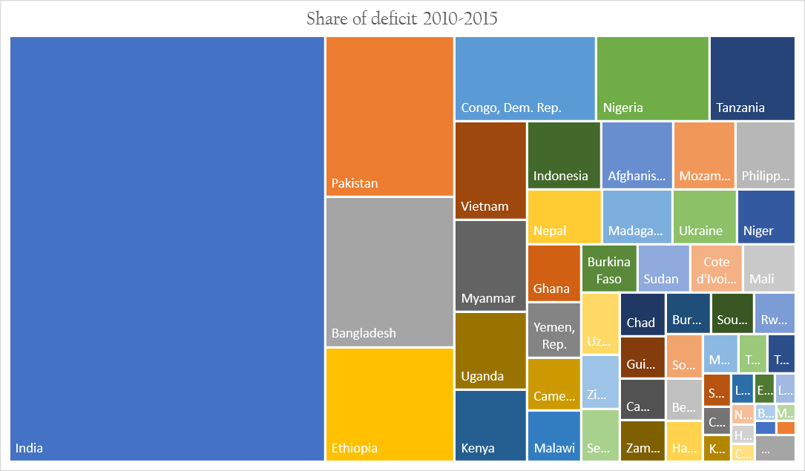
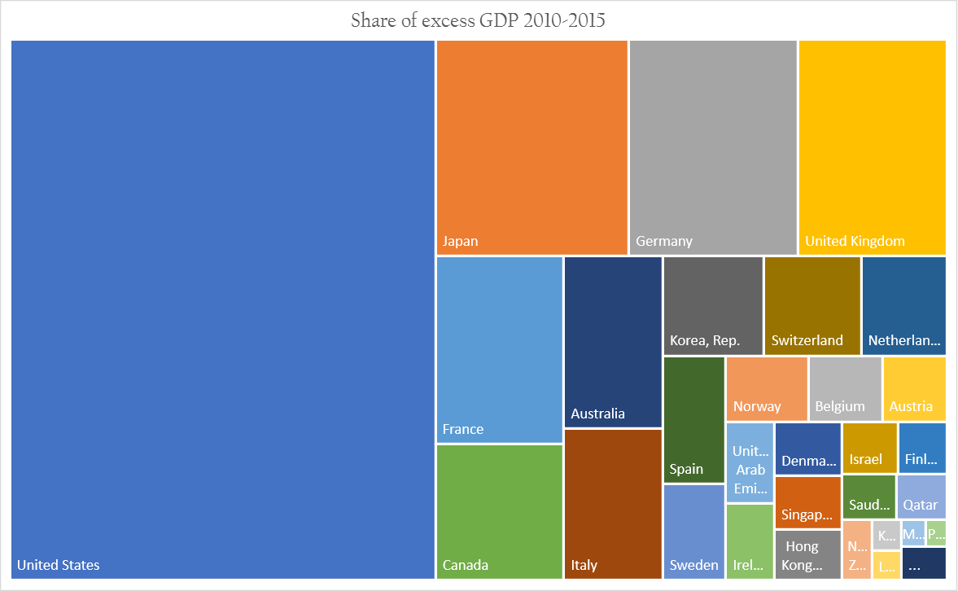
Equity of Access (rights) and contribution (responsability)

Slide 26
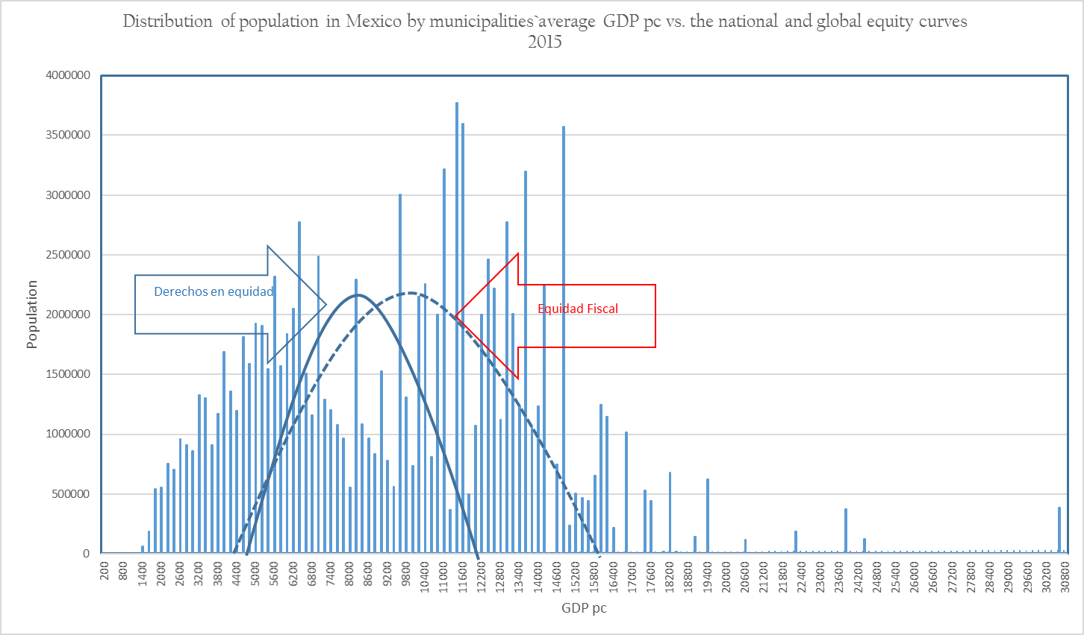
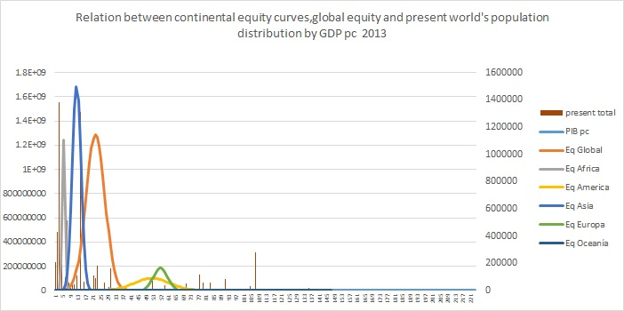
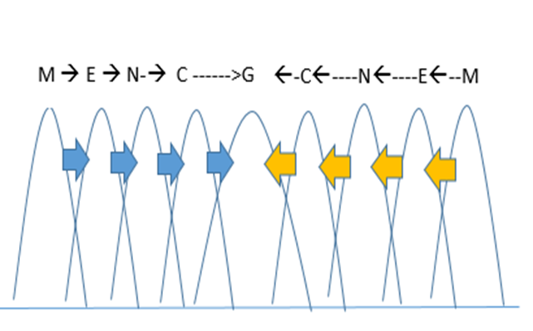
Multi-level territorial equity

Slide 27
2030 agenda –Focus on equity
 | goal | description | Direct relation with Intra-generational Equity | Direct relation with inter-generational equity | Equity indicator
PEOPLE | 1 | End poverty in all its forms everywhere |  |  | Dignity threshold % Pop under D Th
 | 2 | End hunger, achieve food security and improved nutrition and promote sustainable agriculture |  |  | 5 kg N/p-year (from atmosphere to soil)
 | 3 | Ensure healthy lives and promote well-being for all at all ages |  |  | BHiE (Net and relative, age)
 | 4 | Ensure inclusive and equitable quality education and promote lifelong learning opportunities for all
 | 5 | Achieve gender equality and empower all women and girls |  |  | BHiE disaggregated by sex
 | 8 | Promote sustained, inclusive and sustainable economic growth, full and productive employment and decent work for all |  |  | % Pop in equity zone
 | 10 | Reduce inequality within and among countries |  |  | % countries and population with GDP pc < D Th
PLANET | 6 | Ensure availability and sustainable management of water and sanitation for all |  |  | 1565L/p-day
 | 7 | Ensure access to affordable, reliable, sustainable and modern energy for all |  |  | Ethical threshold of carbon footprint pc to avoid 1.5º (13.1 < 1.5º : 1mT pcy)
 | 9 | Build resilient infrastructure, promote inclusive and sustainable industrialization and foster innovation
 | 11 | Make cities and human settlements inclusive, safe, resilient and sustainable
 | 12 | Ensure sustainable consumption and production patterns
 | 13 | Take urgent action to combat climate change and its impacts
 | 14 | Conserve and sustainably use the oceans, seas and marine resources for sustainable development |  |  | 1.57 kg P/p-year (from land to to oceans)
 | 15 | Protect, restore and promote sustainable use of terrestrial ecosystems, sustainably manage forests, combat desertification, and halt and reverse land degradation and halt biodiversity loss |  |  | Biodiversity loss
PEACE | 16 | Promote peaceful and inclusive societies for sustainable development, provide access to justice for all and build effective, accountable and inclusive institutions at all levels
PARTNERSHIPS | 17 | Strengthen the means of implementation and revitalize the global partnership for sustainable development

Slide 28
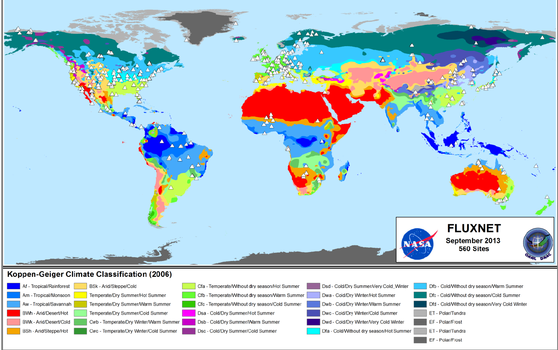
Intergenerational inequity
560 sites of 30y cohort temperature vs age & sex specific mortality rates
Applied to current carbon emission trend and temperatuire increase predictions, and Koppen geoclimatic regions.
218m excess deaths, most after 2070, in >60 years of age, and in low-polluting countries

Slide 29
SDG 10 : reducing inequality within and among countries
 | Target | Required for equity
By 2030, progressively achieve and sustain income growth of the bottom 40 per cent of the population at a rate higher than the national average | Growth lower 40% > average | Pop < D Th : growth to enter equity zone. (Intl : 50% lowest requires growth of
By 2030, empower and promote the social, economic and political inclusion of all, irrespective of age, sex, disability, race, ethnicity, origin, religion or economic or other status
Ensure equal opportunity and reduce inequalities of outcome, including by eliminating discriminatory laws, policies and practices and promoting appropriate legislation, policies and action in this regard
Adopt policies, especially fiscal, wage and social protection policies, and progressively achieve greater equality
Improve the regulation and monitoring of global financial markets and institutions and strengthen the implementation of such regulations
Ensure enhanced representation and voice for developing countries in decision-making in global international economic and financial institutions in order to deliver more effective, credible, accountable and legitimate institutions
Facilitate orderly, safe, regular and responsible migration and mobility of people, including through the implementation of planned and well-managed migration policies
Implement the principle of special and differential treatment for developing countries, in particular least developed countries, in accordance with World Trade Organization agreements
Encourage official development assistance and financial flows, including foreign direct investment, to States where the need is greatest, in particular least developed countries, African countries, small island developing States and landlocked developing countries, in accordance with their national plans and programmes
By 2030, reduce to less than 3 per cent the transaction costs of migrant remittances and eliminate remittance corridors with costs higher than 5 per cent

Slide 30
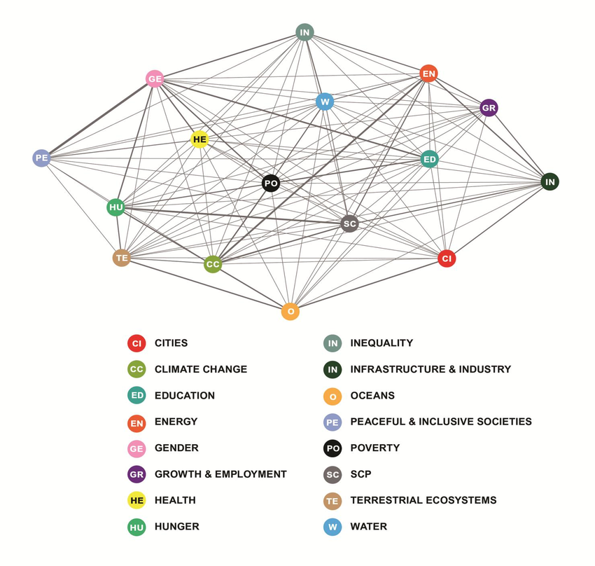
GDP:
3Tn required redistribution:
70Tn production/
consumption
(informal?)
114 Tn stock exchanges (savings)/y
14Tn government revenue
0.027Tn UN budget
0.3Tn remittances (x 10?)
0.1 Tn ODA (x30?)
??
12.8 : De aquí a 2030, asegurar que las personas de todo el mundo tengan la información y los conocimientos pertinentes para el desarrollo sostenible y los estilos de vida en armonía con la naturaleza.
12.8 -→ 13.1 :
Conocer umbral ético pc, limitar, difundir

Slide 31
Responsability on excess accumulation and on excess carbon emissions
GDP above excess level :
6Tn excess GDP/850m LYL (17m excess deaths : 90% in deficit countries) ):
7000 excess $/LYL
Av EU : 80LYL /lifetime, Av US : 400 LYL/lifetime
Carbon emissions above ethical threshold :
400,000 mill mT excess carbon emissions/218m excess deaths 2020-2100 (90% in non-poilluting countries)
1814 mT in excess per excess deaths
Av EU : 1/3 excess death/lifetime, Av USA : 1 excess death/lifetime

Slide 32
Conclussions
Consider replicable and sustainable development models vs DAC/HIC models
Move from poverty to dignity thresholds
Burden of health inequity by local, national , regional and international levels.
Link to territorial cohesion at local, national , regional and international levels.
Link to fiscal equity aimed at equity distribution.
Integrgenerational inequity and link to planetary boudaries through social awareness
( SDG 12.8 (By 2030, ensure that people everywhere have the relevant information and awareness for sustainable development and lifestyles in harmony with nature) and political commitments (renewed COP21 and others)
Consider measurable SDG targets on age/sex/subnat. disaggregated burden of health inequity, economic equity and planetary boundaries.

