Slide 1
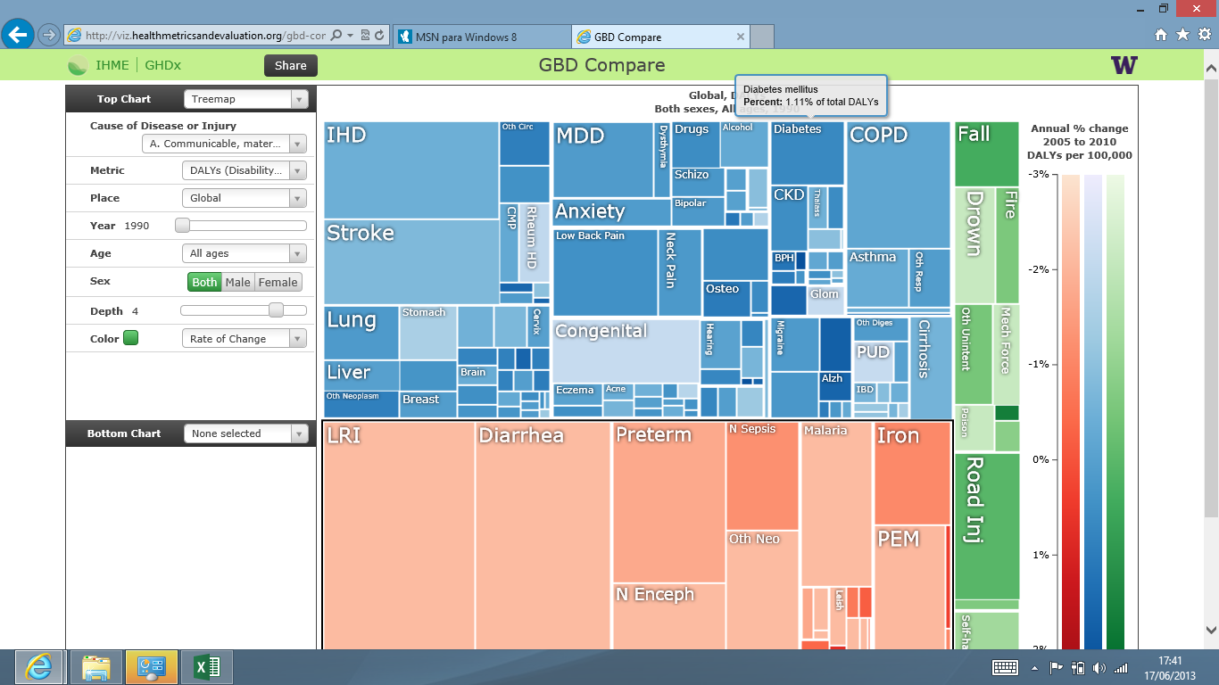
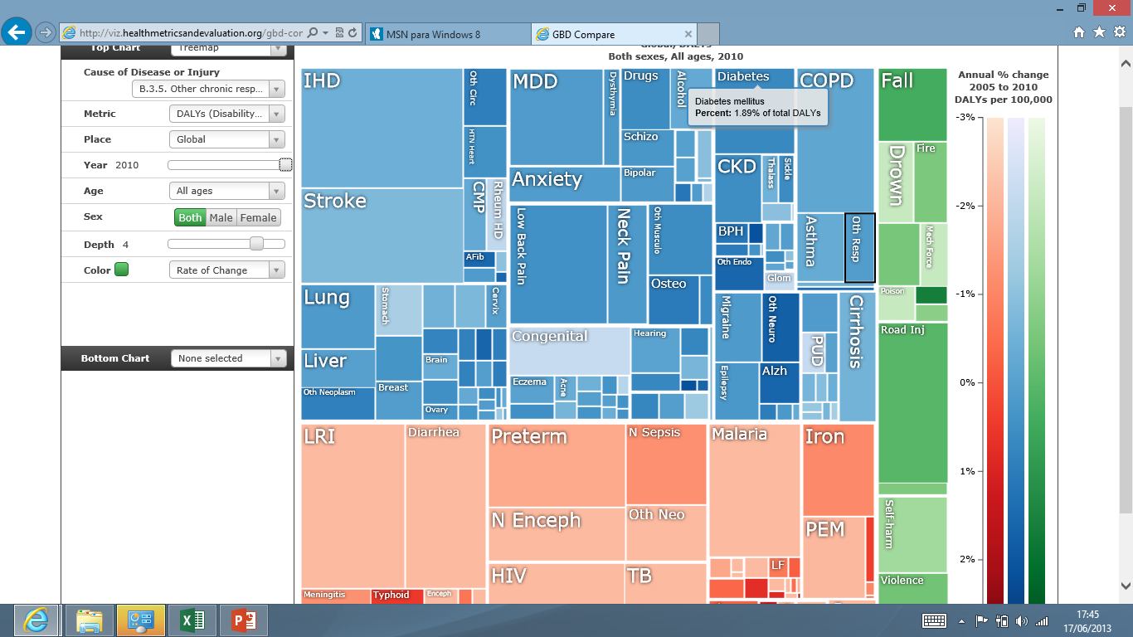

Slide 2
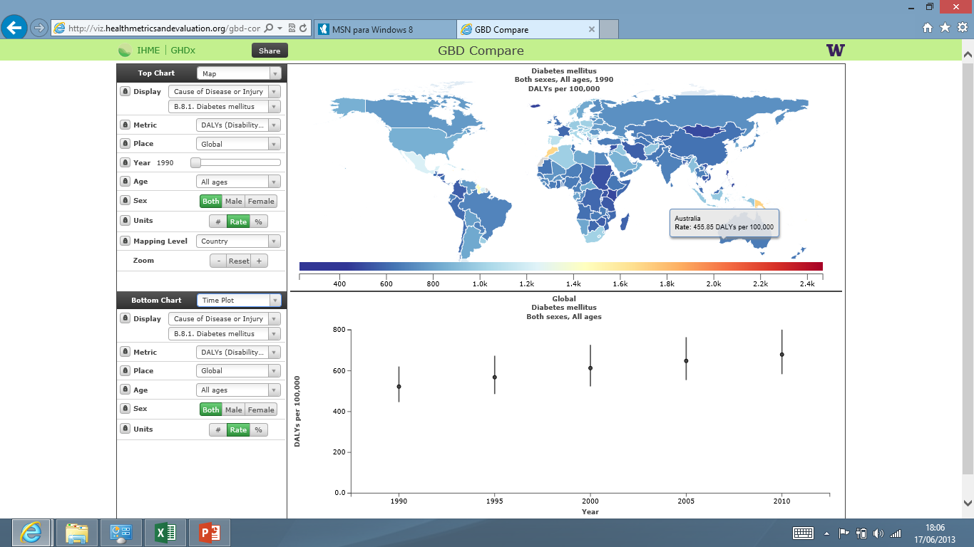
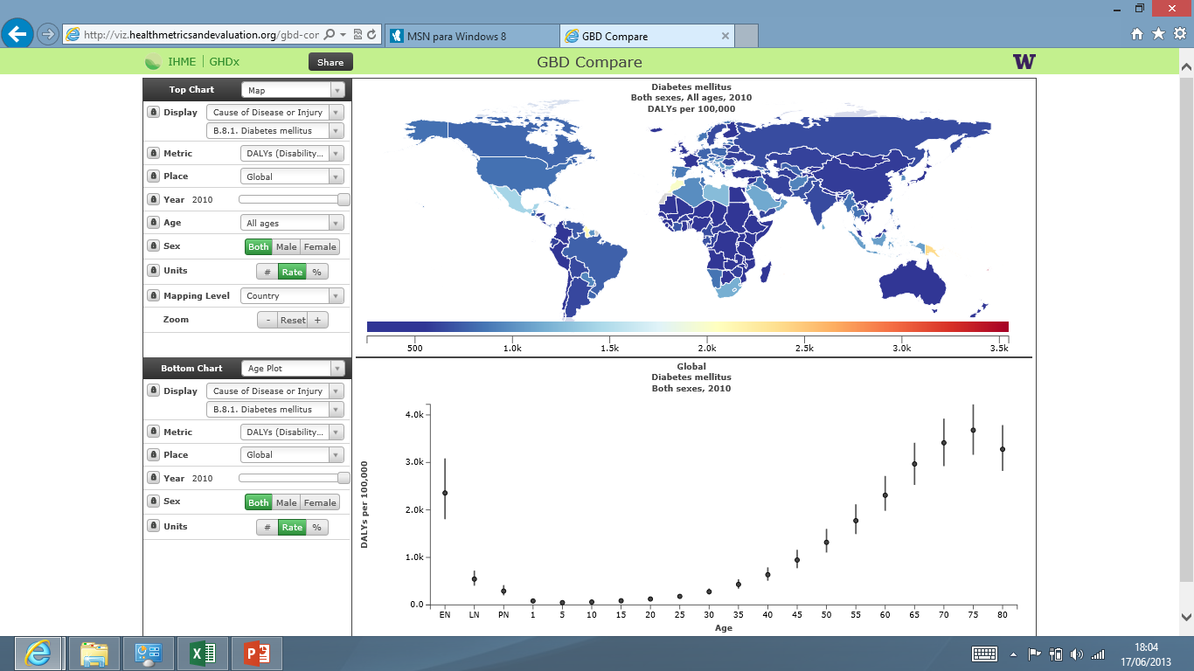

Slide 3
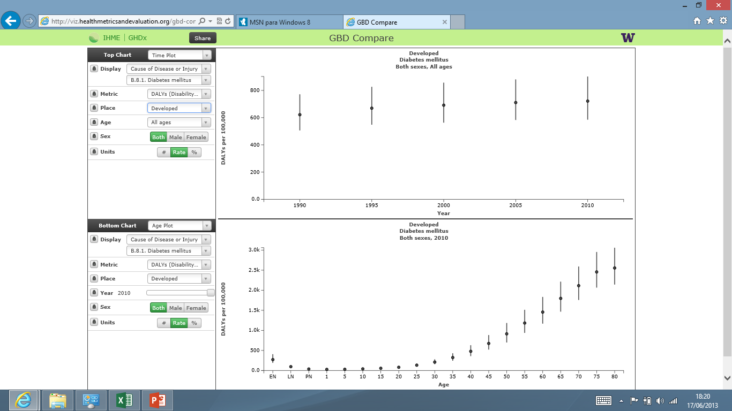


Slide 4
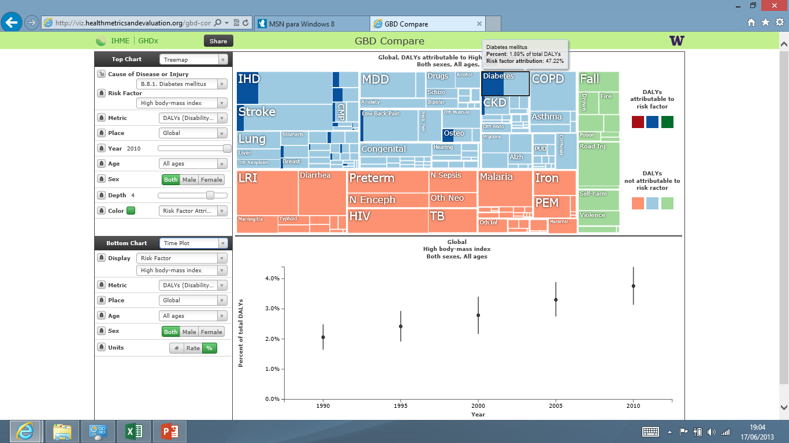
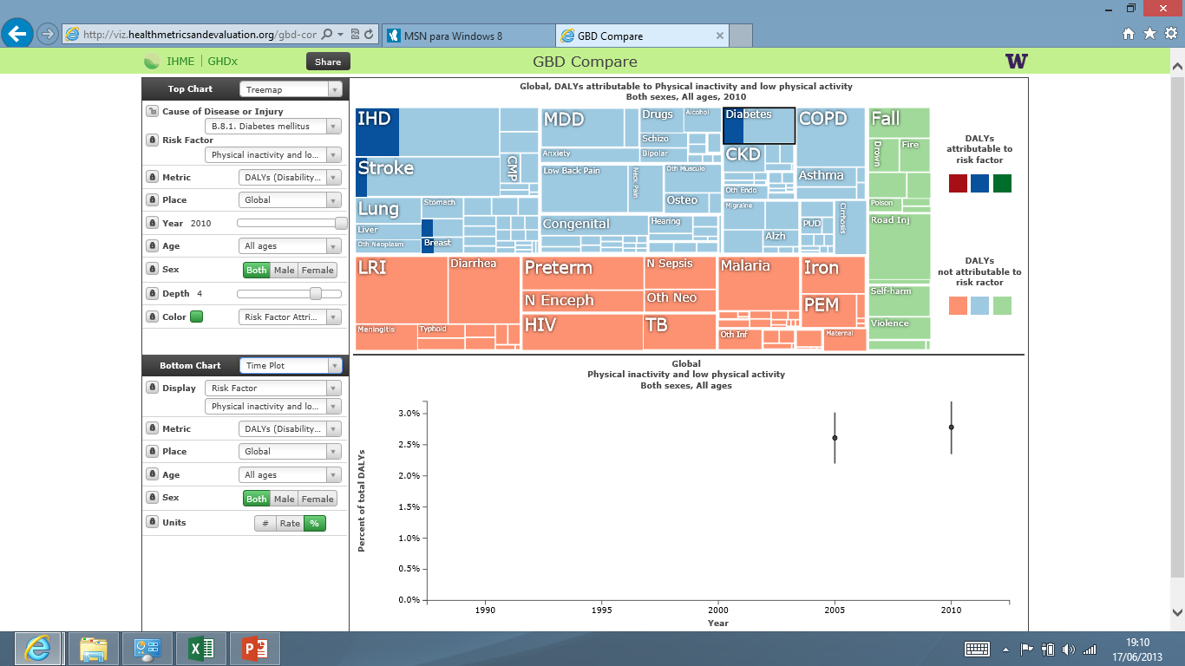
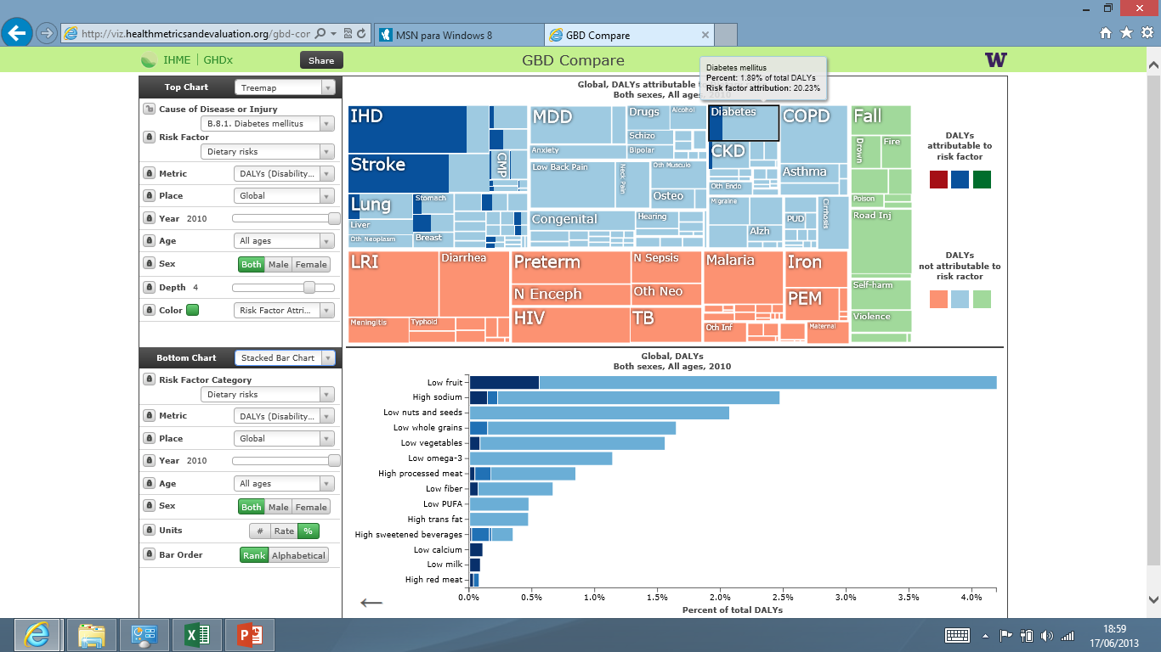

Slide 5
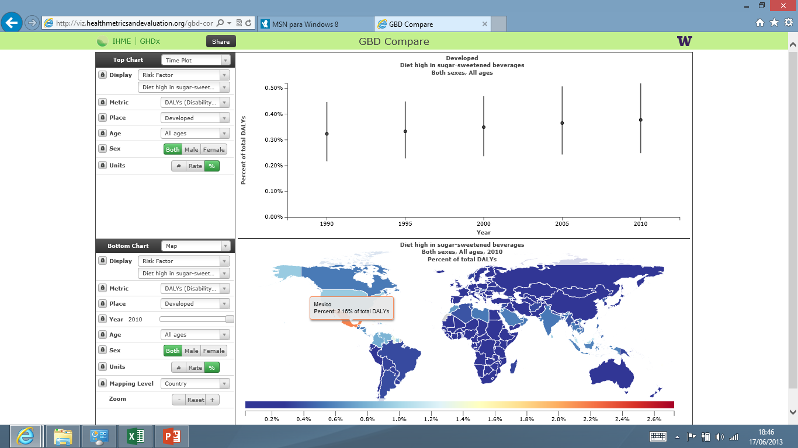

Slide 6
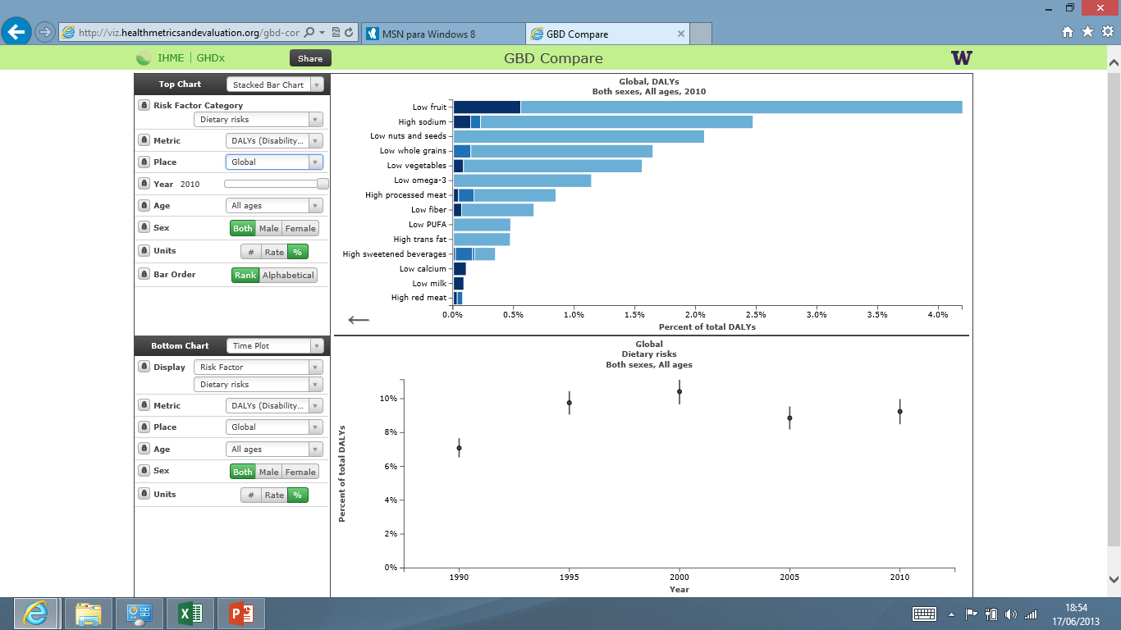
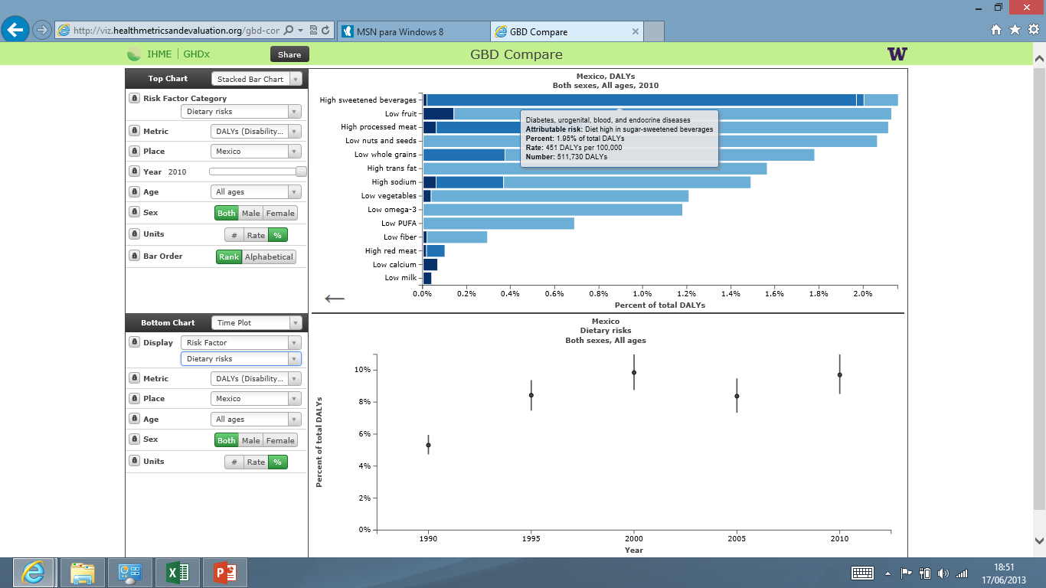

Slide 7
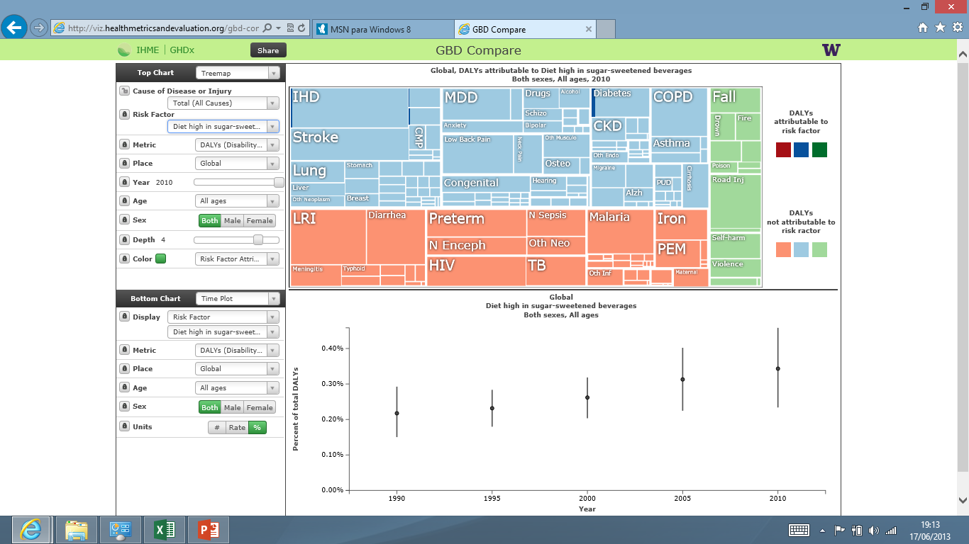
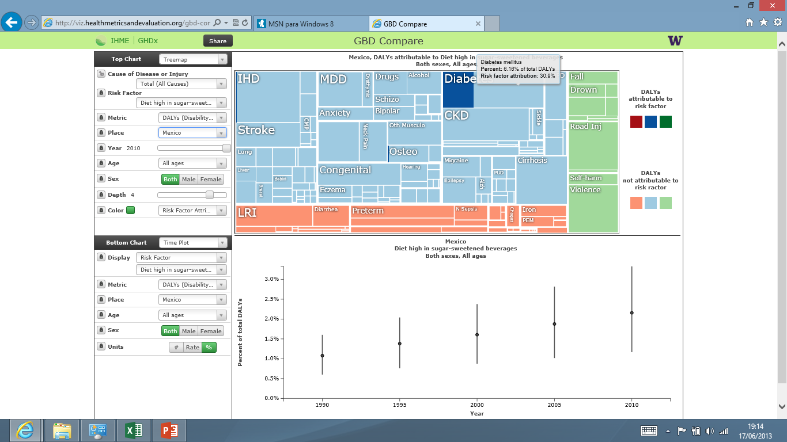

Slide 8
Sugary and zero protein drinks in Mexico
152 liters of sugary drink per year per person, 70% cola
7% of income to buy sugary drinks in one million selling points in the country
Increase of 40% while similar decrease in fruits and vegetables
One sugary drink can contains some 13 spoonfulls of sugar, gradually being changed by cheaper fructose or maize syrup, more directly connected to obesity (as the body cannot digest them).
Influencing overweight in 25% of 4-10 years, 35% of 10-25 years and 70% of those over 40 years.
Consequence in diabetes and hypertension, and increased risks of cardiovascular diseases. With cola´s forsforic acid also osteoporosis, and cafeine hyperactivity and insomnia.
Some 580,000 DALYs lost (healthy life years) and 17,000 deaths per year.
Notes:
http://www.oem.com.mx/laprensa/notas/n752335.htm

Slide 9
Potential benefits of regulating the market of sugary drinks in Mexico
15, 000 million liters, some 30 billion dollar sales and some 3 billion dollar benefits per year.
Each 6,000 dollars of benefit relates to one life year lost and each 200,000 dollars relaes to one death attributable to sugary drink intake.
If cost would be inversely correlated with consumption, introducing taxes at a 100% of the price (doubling it) would save 8,000 lives a year, 250,000 healthy life years, increase household resurces by 10%, the productivity and the economy of the country by 0,2% and reduce health care costs by 2%, that is some 1,200 million dollars per year (400 million by halving diabetes raleted costs in the long term).
The taxes collected, some 30 billion, could be used to further reduce the consumption and promote healthier nutrition and lifestyles.

